Slide 1

Managed Security in the Power Platform: What’s in the box
Juan Carlos González | Microsoft 365 & Microsoft 365 Copilot MVP | Microsoft 365 SME

Slide 2






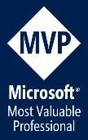



@jcgm1978 | @jcgm1978.bsky.social
jcgonzalezmartin1978@hotmail.com
https://nl.linkedin.com/in/juagon
https://jcgonzalezmartin.wordpress.com/
https://www.youtube.com/@jcgonzalezmartin
https://office365itpros.com/
#CollabDaysBE2025

Slide 4
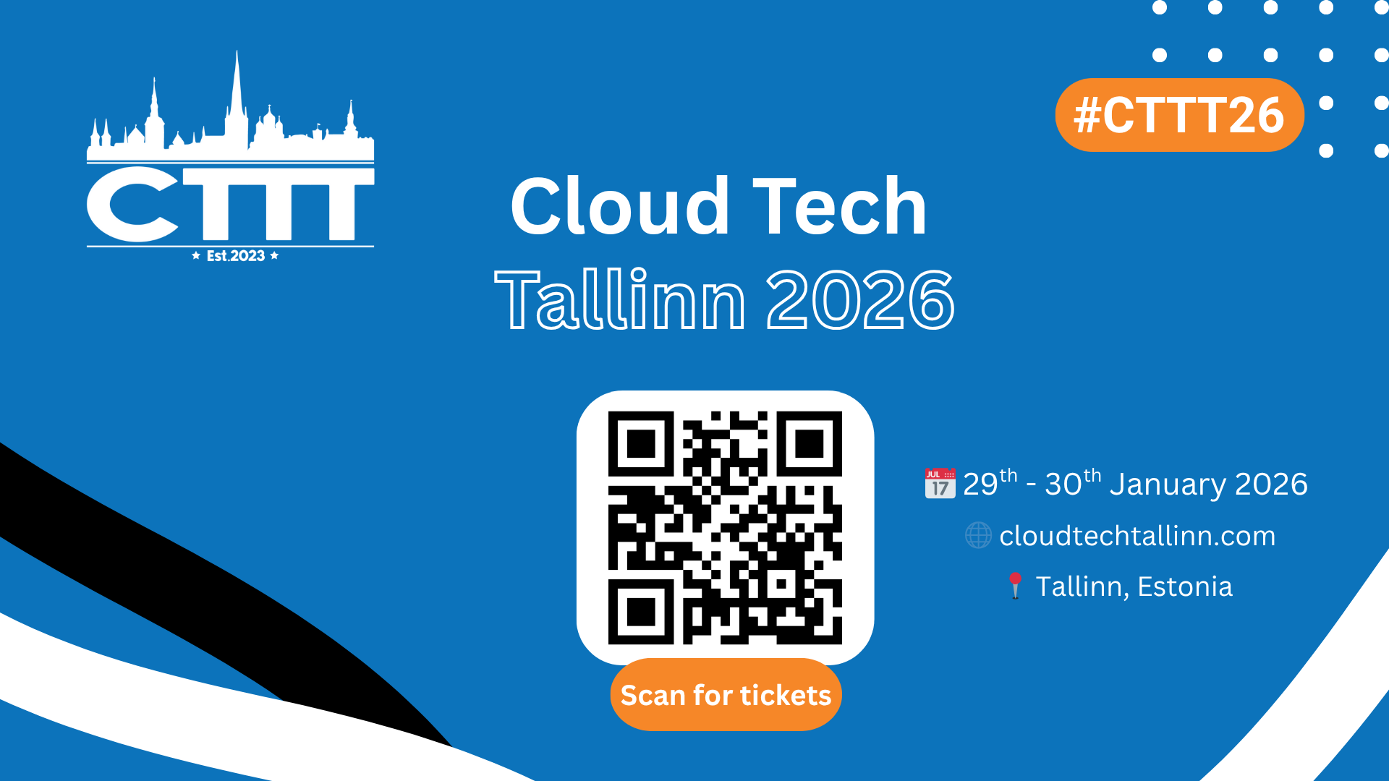

Slide 5
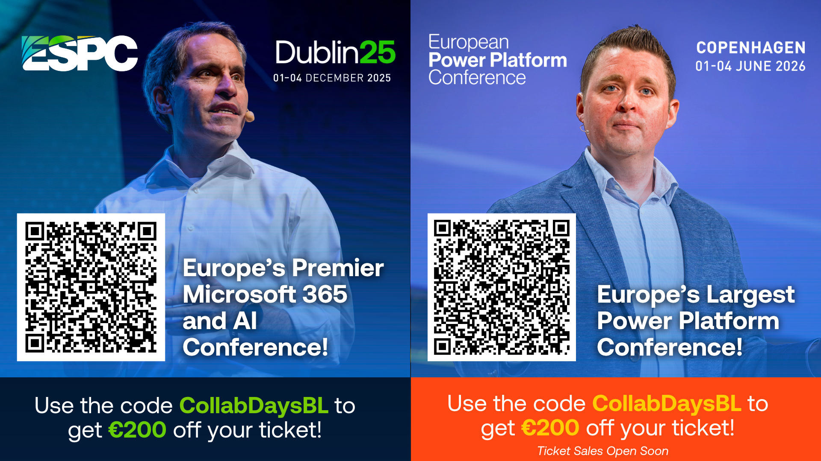

Slide 6


Slide 7
Agenda
Why are we talking about Managed Security in the Power Platform?
Managed Security and Security Posture in the Power Platform
Data Protection & Privacy
Identity & Access Management + Network Security
Compliance & Auditing
Thread Protection
#CollabDaysBE2025
Notes:
Protecting data and platforms is a must
Security layers & Managed Security in the Power Platform
Identity & Access Management + Network Security
Data Access Management, Data Security and Data Loss Prevention
Compliance Standards and Regulations
------------------------------------------------------------------------------
Compliance: Implement robust compliance measures to safeguard organizational data and ensure adherence to industry regulations through features such as Customer Lockbox.
Data protection and privacy: Ensure that personal information is securely handled, stored, and protected in a way that maintains confidentiality and integrity and prevents unauthorized access. Features such as Azure Virtual Network, customer-managed keys, data policies, data masking, and Microsoft Purview Data Map help protect applications and cloud workloads from network-based cyberattacks.
Identity and access management: Ensure that only authorized users can access specific resources, through features such as IP firewall, IP cookie binding, Manage sharing, conditional access policies for individual apps, managed identities for Dataverse plug-ins, and privileged access.
Threat protection: Protect your organization's assets and resources through unified detection by using Microsoft Sentinel solution for Power Platform. This solution allows for intelligent detection and responses to suspicious activities, such as mass data deletion or unauthorized app execution. In this way, it enhances your security posture and effectively mitigates potential threats.

Slide 8


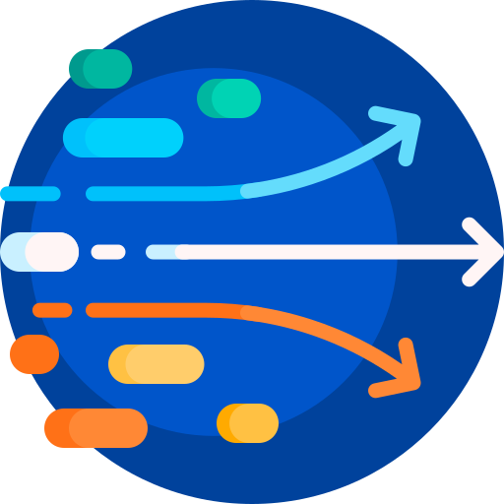

Data Protection Landscape is constantly changing
Growing sophistication of attacks
Explosion of AI scenarios requires a correct and secure access to data
Data access demands from an increasingly dynamic workforce
Regulatory and legal requirements are constantly evolving
The why….
#CollabDaysBE2025
Notes:
Growing sophistication of attacks
Drive to leverage data to unlock AI-driven scenarios
Data access demands from an increasingly dynamic workforce
Evolving regulatory and legal requirement

Slide 9

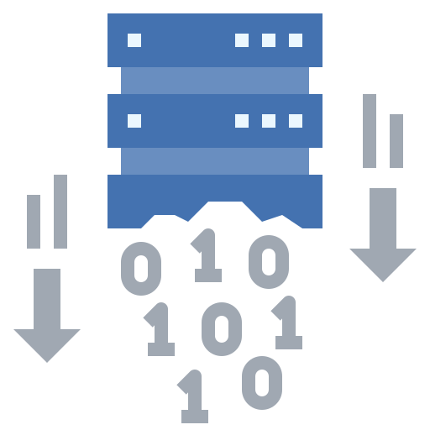



How can I keep data secure?
Controlling and limiting access to data
Preventing data exfiltration
Staying compliant with standards and regulations
The how….
Protecting data from external threats
Gaining visibility into user activity
Doing risks assessments
#CollabDaysBE2025
Notes:
How can I control and limit access to data?
How can I prevent data exfiltration?
How can I stay compliant with regulations?
How can I protect my data from external threats?
How can I gain visibility into user activity?
How can I assess the risk?

Slide 10
Top 10 No Code/Low Code security vulnerabilities
Account impersonation
Misuse of authorization
Data leakage and unexpected consequences
Failures of authentication and secure communication
Misconfigured security
Injection handling failures
Vulnerable and untrusted components
Failure to handle data and secrets properly
Failure to manage assets securely
Failures of security logging and monitoring
1
6
2
7
3
8
4
9
10
5
The security problems…
OWASP Low-Code/No-Code Top 10 | OWASP Foundation
#CollabDaysBE2025
Notes:
Account impersonation -> SQL -> EAB: preguntar al público: ¿cuántos sabéis qué copnsecuencias tiene compartir una conexión en Power Platform?
Misuse of authorization -> Rol (autenticacion vs autorizacion)
Data leakage and unexpected consequences -> origen datos mal compartido
Failures of authentication and secure communication -> power pages
Misconfigured security -> charla
Injection handling failures -> injeccion en sql
Vulnerable and untrusted components -> PCF
Failure to handle data and secrets properly -> como se guarda. HTTP conector
Failure to manage assets securely -> muchas apps y usuarios que se mueven
Failures of security logging and monitoring -> insights

Slide 11
Managed Security in the Power Platform
Advanced protection for an AI-driven world
Security Posture Management
Data Protection
and Privacy
Identity and Access
Management + Network Security
Compliance
Threat Protection
Intelligent guidance for scalable and efficient enterprise-grade security.
Robust controls to ensure confidentiality and encryption, ensuring security of sensitive information.
Seamless and adaptive tools to ensure only authorized resource and data access.
Assured visibility and adherence to industry and regional regulatory requirements.
AI-powered detection and monitoring to address and prevent security risks.
Security guidance
Customer managed keys
IP Firewall
Lockbox
Enforceable solution checker
Data masking
Resource sharing limits
Dataverse audit
Microsoft Sentinel integration
Microsoft Purview Data map integration
IP cookie binding
Thread Detection for Copilot Agents
Data policies (desktop flows)
Tenant Isolation
Microsoft Defender for Copilot Agents
Advanced connector policies
Privileged Access Management
Network
Isolation (v-Net)
Client app access
Conditional Access
Agent Access & Authentication
#CollabDaysBE2025

Slide 12
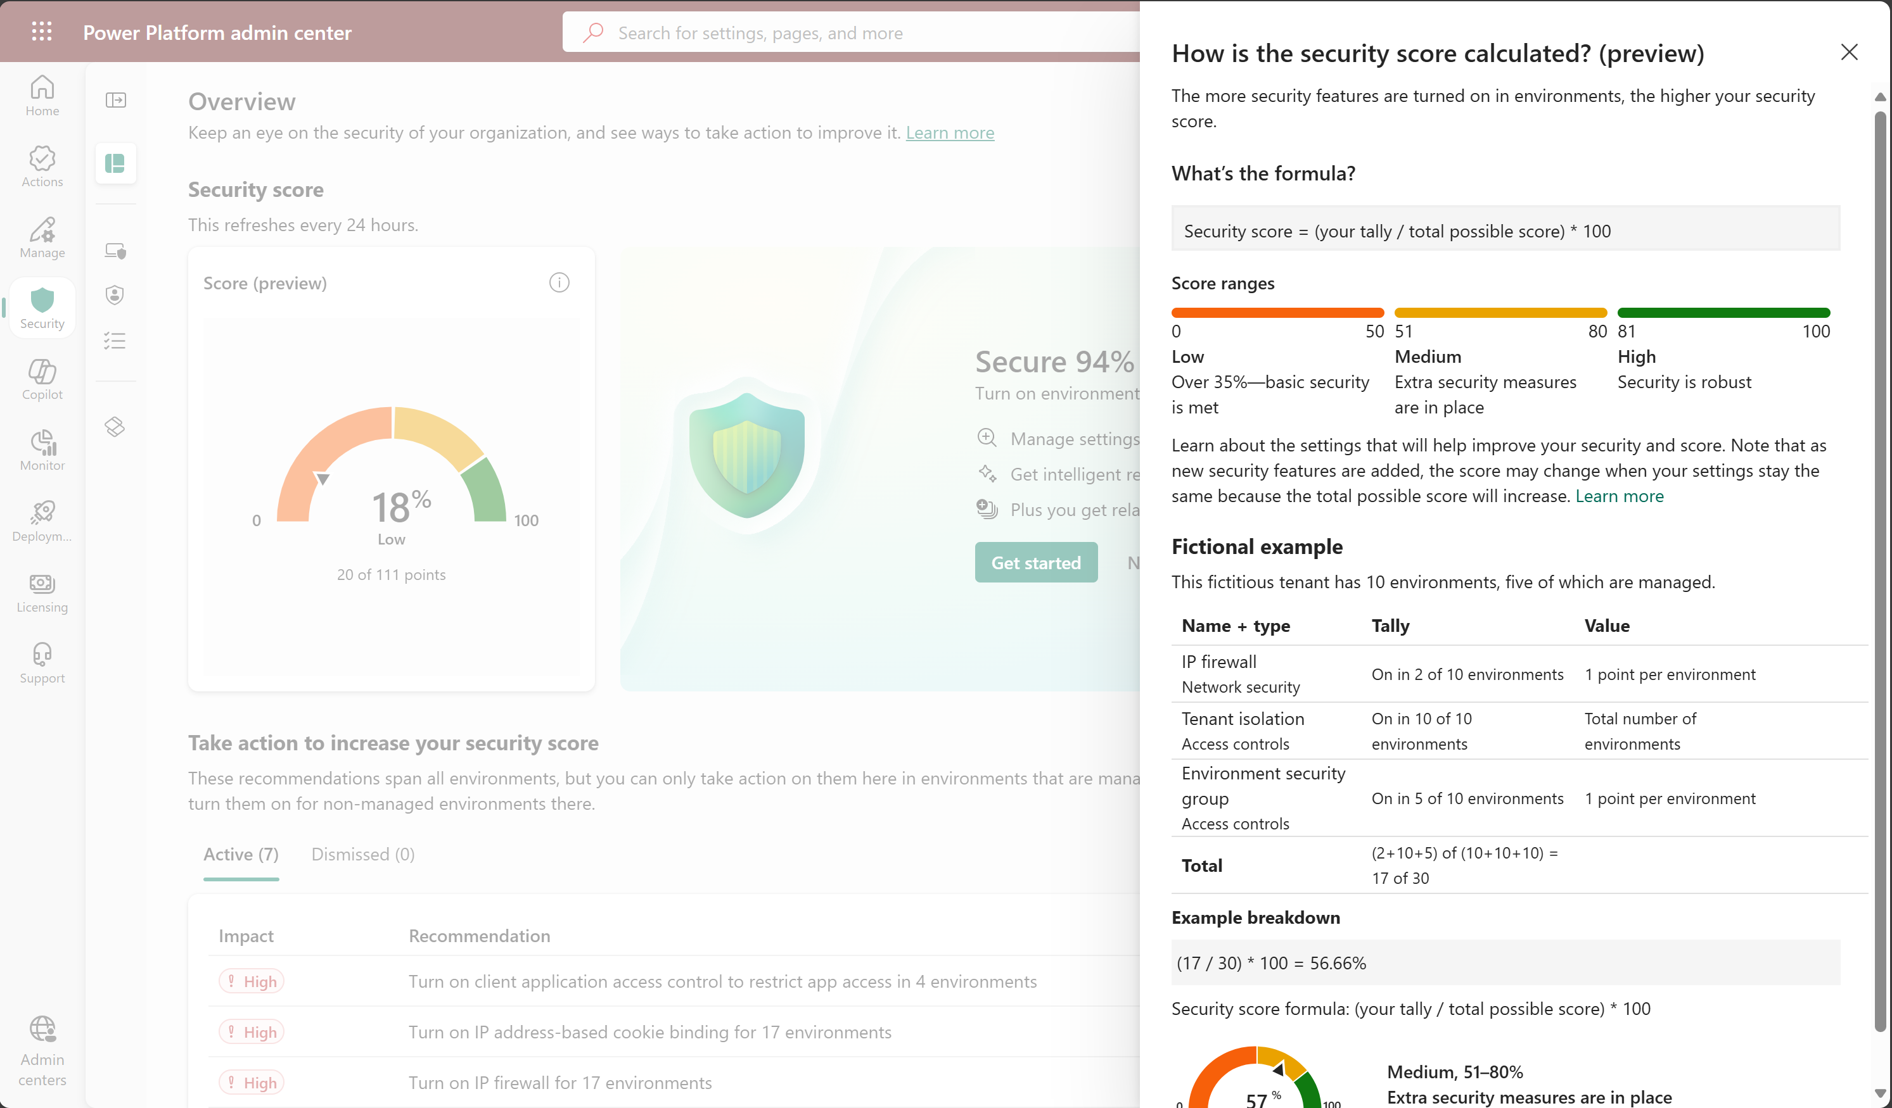
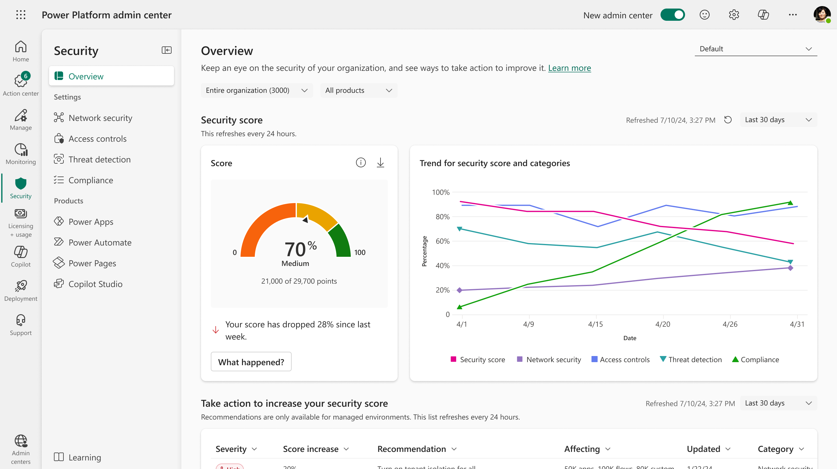
Managed Security in the Power Platform
#CollabDaysBE2025

Slide 13


Demo #1: Security Posture in the Power Platform
#CollabDaysBE2025
Notes:
Power Platform Security Hub

Slide 14



Data Protection & Privacy
Ensure that personal information is securely handled, stored, and protected in a way that maintains confidentiality and integrity and prevents unauthorized access
Self-managed encryption key
Prevents access to corporate data by anyone outside the organization (Including Microsoft)
Allows to rotate or swap the encryption key on demand
Protect sensitive information during customer interactions and prevents data leaks
Masked strings ensure that the original, unmasked values remain hidden
It uses obfuscation rules with regex to mask sensitive data
Power Platform Data (Dataverse) Governance and Discovery
Data Classification + Application of Sensitivity Labels and Compliance Policies to the data
Customer Managed Keys
Data Masking (Preview)
Microsoft Purview Data Map
#CollabDaysBE2025
Notes:
Data Protection & Privacy: Customer managed keys | Data masking | Microsoft Purview Data map | Data policies | Advaced connector policies | Network Isonaliton (v-Net)
Data protection and privacy: Ensure that personal information is securely handled, stored, and protected in a way that maintains confidentiality and integrity and prevents unauthorized access. Features such as Azure Virtual Network, customer-managed keys, data policies, data masking, and Microsoft Purview Data Map help protect applications and cloud workloads from network-based cyberattacks.
Customer Managed Keys: All customer data stored in Power Platform is encrypted at-rest with strong Microsoft-managed encryption keys by default. Microsoft stores and manages the database encryption key for all your data so you don't have to. However, Power Platform provides this customer-managed encryption key (CMK) for your added data protection control where you can self-manage the database encryption key that is associated with your Microsoft Dataverse environment. This allows you to rotate or swap the encryption key on demand, and also allows you to prevent Microsoft's access to your customer data when you revoke the key access to our services at any time.
Data Masking: Data masking helps protect sensitive information during customer interactions and prevents data leaks. Data masking, also known as de-identification or obfuscation, replaces sensitive data with masked strings. The masked strings ensure that the original, unmasked values remain hidden. Only authorized users can read the unmasked values—one record at a time. In the context of customer interactions, frontline support users are prevented from exposing sensitive information like credit card numbers, social security numbers, or any personal data.

Slide 15
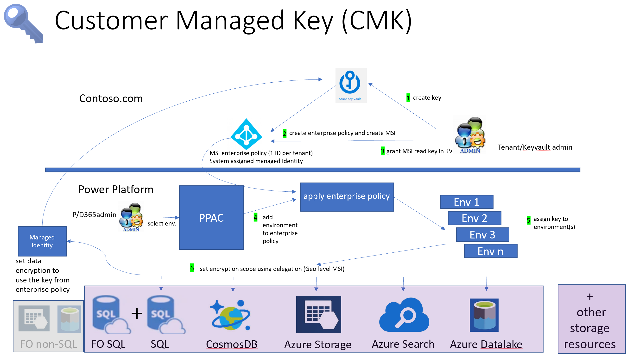
Data Protection & Privacy
Manage your customer-managed encryption key - Power Platform | Microsoft Learn
#CollabDaysBE2025

Slide 16
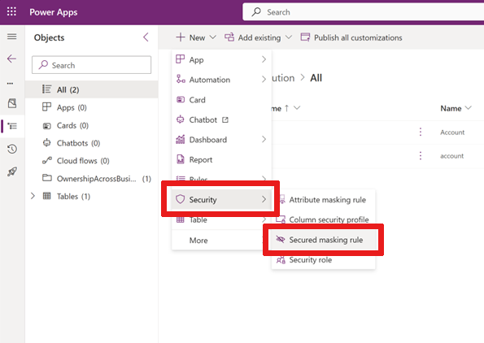
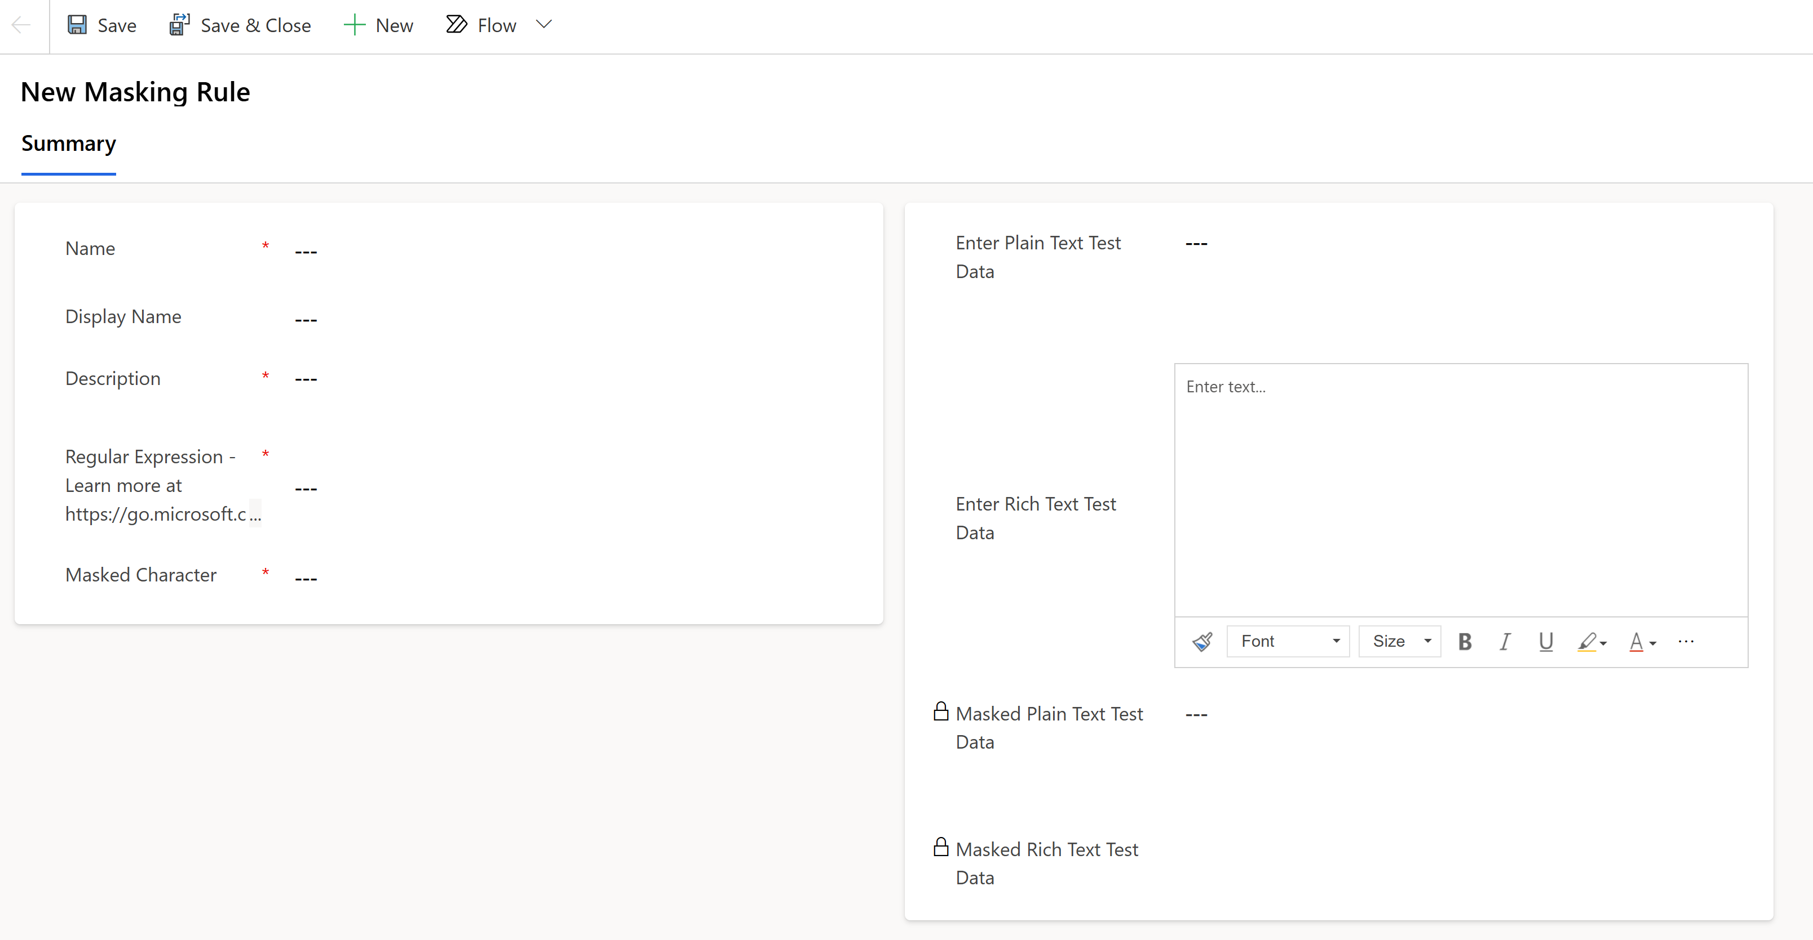
Data Protection & Privacy
Create and manage masking rules (preview) - Power Platform | Microsoft Learn
1
2
Adding a new Secured masking rule within a solution
Configure Secured masking rule
#CollabDaysBE2025

Slide 17

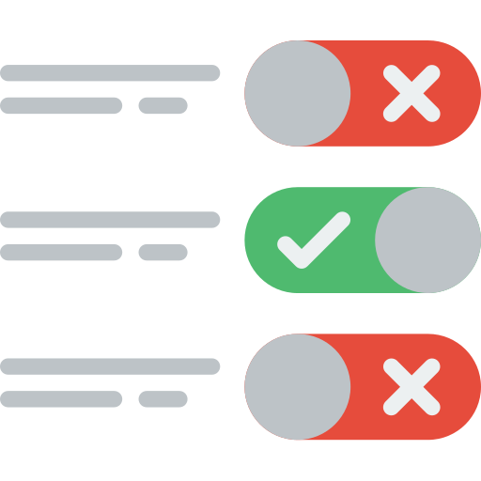

Data Protection & Privacy
Ensure that personal information is securely handled, stored, and protected in a way that maintains confidentiality and integrity and prevents unauthorized access
Prevent makers to expose corporate Information
At Design Time, prevent makers from building apps and flows that leverage blocked connectors
2 levels of Application: Tenant-Wide vs. Environment
(In Preview) Managed allowed/blocked connectors at scale (Environment Groups)
Connect the Power Platform to your private and protected resources without exposing them to the internet
Scope supported: Dataverse plugins, selected connectors
Data Policies (Run time vs. Design Time)
Advanced Connector Policies
Network Isolation (Azure v-Net support)
#CollabDaysBE2025
Notes:
Data Protection & Privacy: Customer managed keys | Data masking | Microsoft Purview Data map | Data policies | Advaced connector policies | Network Isonaliton (v-Net)
Data protection and privacy: Ensure that personal information is securely handled, stored, and protected in a way that maintains confidentiality and integrity and prevents unauthorized access. Features such as Azure Virtual Network, customer-managed keys, data policies, data masking, and Microsoft Purview Data Map help protect applications and cloud workloads from network-based cyberattacks.
Advanced Connector Policies: Advanced connector policies (ACP) represent the next generation of securing connector usage within the Power Platform. This feature provides a modern and flexible approach to managing all certified connectors, aligning with the broader governance strategy of per-environment security controls paired with environment group support.
Azure Virtual Network:
Data protection: Virtual Network allows Power Platform services to connect to your private and protected resources without exposing them to the internet.
No unauthorized access: Virtual Network connects with your resources without needing Power Platform IP ranges or service tags in the connection

Slide 18
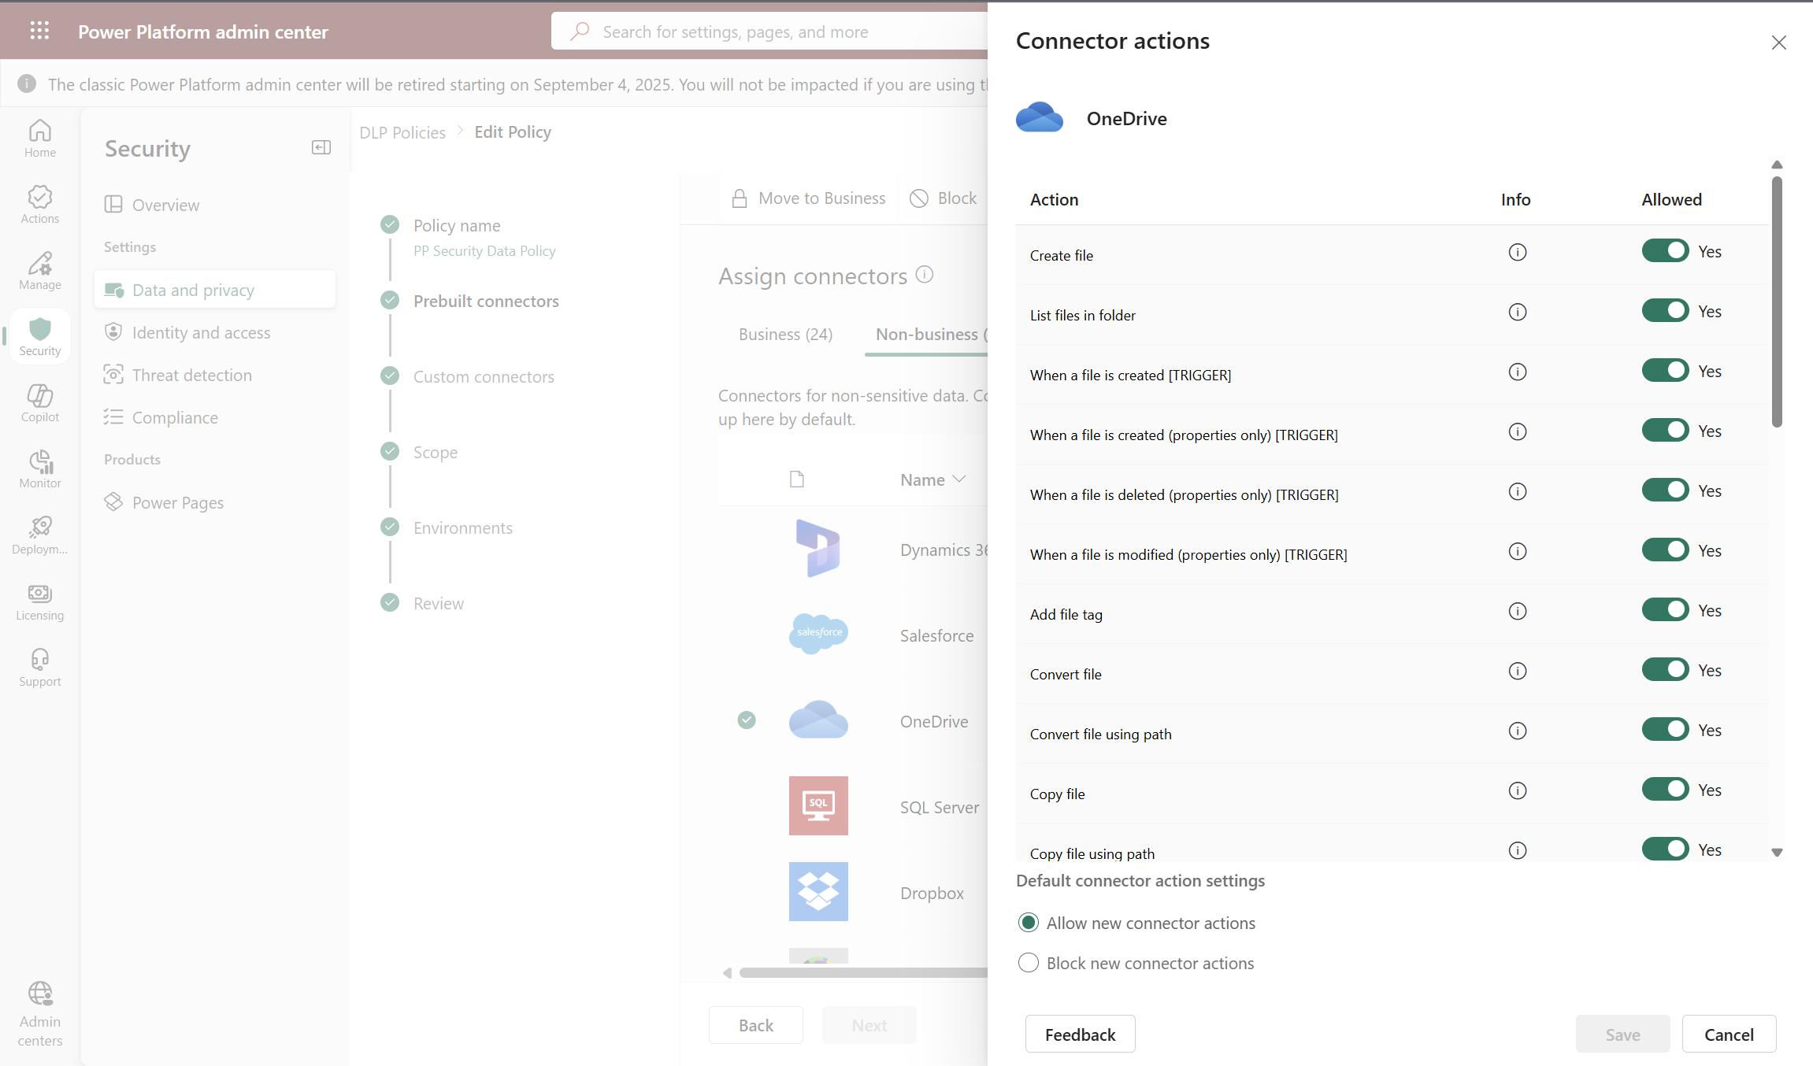
Data Protection & Privacy
Connector action control - Power Platform | Microsoft Learn & Connector endpoint filtering (preview) - Power Platform | Microsoft Learn
Access Data and privacy settings
1
Select a connector that can be blokecd
2
Granular setup of Connector Actions
3
Allow/Block new connector actions
4
#CollabDaysBE2025

Slide 19
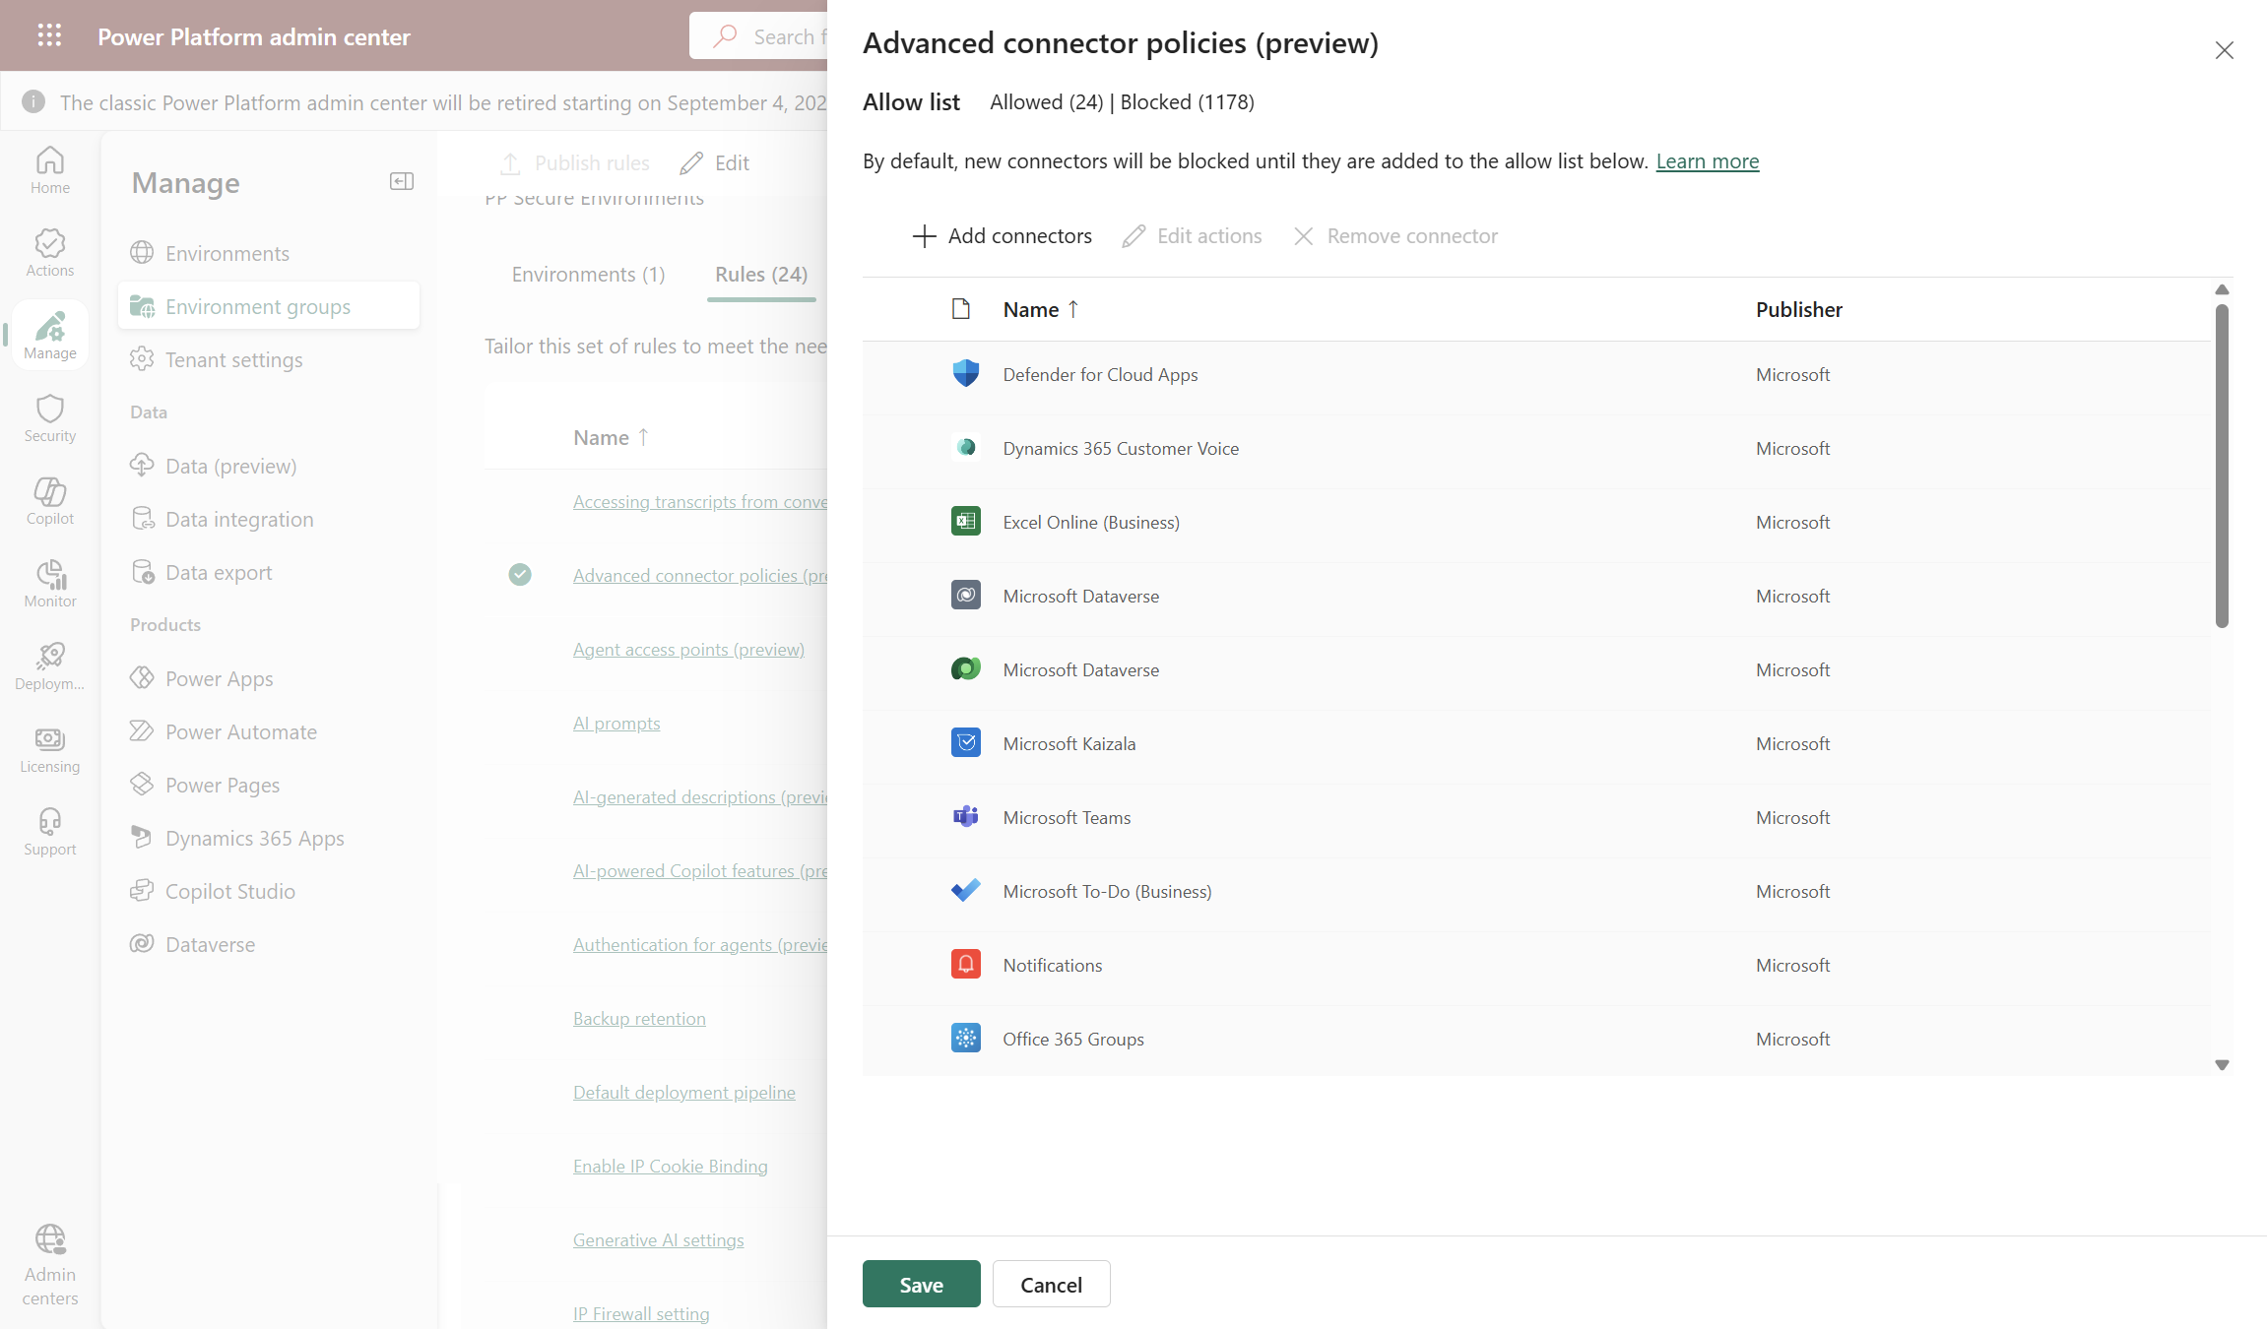
Data Protection & Privacy
Connector action control - Power Platform | Microsoft Learn & Connector endpoint filtering (preview) - Power Platform | Microsoft Learn
2
Rules -> Advanced connector policies
Add/Update connectors allowed in an Environment group
Access to Environment groups
3
1
Support for certified, custom, virtual and MCP connectors
4
#CollabDaysBE2025
Notes:
Advanced connector policies (ACP) represent the next generation of securing connector usage within the Power Platform. This feature provides a modern and flexible approach to managing all certified connectors, aligning with the broader governance strategy of per-environment security controls paired with environment group support.
By adopting advanced connector policies, administrators gain greater control and granularity in securing and managing connector usage while enhancing the overall governance of their Power Platform environments.
Data policies - Power Platform | Microsoft Learn

Slide 20
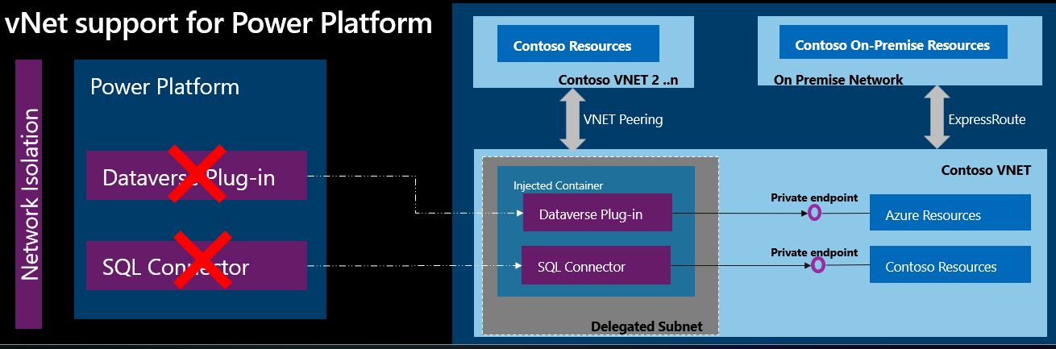
Data Protection & Privacy
Virtual Network support overview - Power Platform | Microsoft Learn
#CollabDaysBE2025
Notes:
With Azure Virtual Network support for Power Platform, you can integrate Power Platform with resources inside your virtual network without exposing them over the public internet. Virtual Network support uses Azure subnet delegation to manage outbound traffic from Power Platform at runtime. Using Azure Subnet delegation avoids the need for protected resources to be available over the internet to integrate with Power Platform. With virtual network support, Power Platform components can call resources owned by your enterprise inside your network, whether they're hosted in Azure or on-premises, and use plug-ins and connectors to make outbound call

Slide 21
Demo #2: Data Protection & Privacy
#CollabDaysBE2025
Notes:
Customer Key – Video in Microsoft Learn: https://learn.microsoft.com/en-us/power-platform/admin/customer-managed-key
Data Masking
Data Policies: Global vs. Grupo de Entornos vs. Entorno
Advaced Connector Policies

Slide 22



Identity & Access Management + Network Security
Ensure that only authorized users can access specific resources
Prevents malicious users, outside allowed IP ranges, from accessing your data
Mitigate insider threats like data exfiltration + Prevent token replay attacks
Current Scope: Dataverse (Managed Environments, Environment Groups, OData EndPoints)
Limit how broadly users can share canvas apps, flows, and agents
2 levels of application: Environment vs. Environment Group
Prevents attackers using cookies to impersonate an authorized user
Current Scope: Dataverse (Managed Environments)
Restrict to/from cross tenant connections established via Power Platform Apps and flows
Allow exception through rules based on business needs
IP Firewall
Resource Sharing Limits
IP Cookie Binding
Tenant Isolation
#CollabDaysBE2025
Notes:
Identity and access management: Ensure that only authorized users can access specific resources, through features such as IP firewall, IP cookie binding, Manage sharing, conditional access policies for individual apps, managed identities for Dataverse plug-ins, and privileged access.
Identity & Acces Management + Network Security: IP Firewall | Resource sharing limits | IP cookie binding | Tenant Isolationt | PIM | Client app Access | Conditional Access for Individual Canvas Apps | Agent Access & Authentication
IP Firewall: The IP firewall feature in Microsoft Power Platform is a security control that applies only to Managed Environments with Dataverse. It provides a critical layer of security by controlling inbound traffic to Power Platform environments. Administrators can use this feature to define and enforce IP-based access controls. In this way, they can ensure that only authorized IP addresses can access the Power Platform environment. By using IP firewall, organizations can mitigate risks that are associated with unauthorized access and data breaches, and therefore enhance the overall security of their Power Platform deployments. Learn more in IP firewall in Power Platform environments.
Resource Sharing Limits: In Managed Environments, admins can limit how broadly users can share canvas apps, flows, and agents.
IP Cookie Binding: Prevent session hijacking exploits in Dataverse with IP address-based cookie binding. Let's say that a malicious user copies a valid session cookie from an authorized computer that has cookie IP binding enabled. The user then tries to use the cookie on a different computer to gain unauthorized access to Dataverse. In real time, Dataverse compares the IP address of the cookie's origin against the IP address of the computer making the request. If the two are different, the attempt is blocked, and an error message is shown.
Power Platform tenant Isolation: Power Platform tenant isolation is different from Microsoft Entra ID-wide tenant restriction. It doesn't impact Microsoft Entra ID-based access outside of Power Platform. Power Platform tenant isolation only works for connectors using Microsoft Entra ID-based authentication such as Office 365 Outlook or SharePoint.

Slide 23
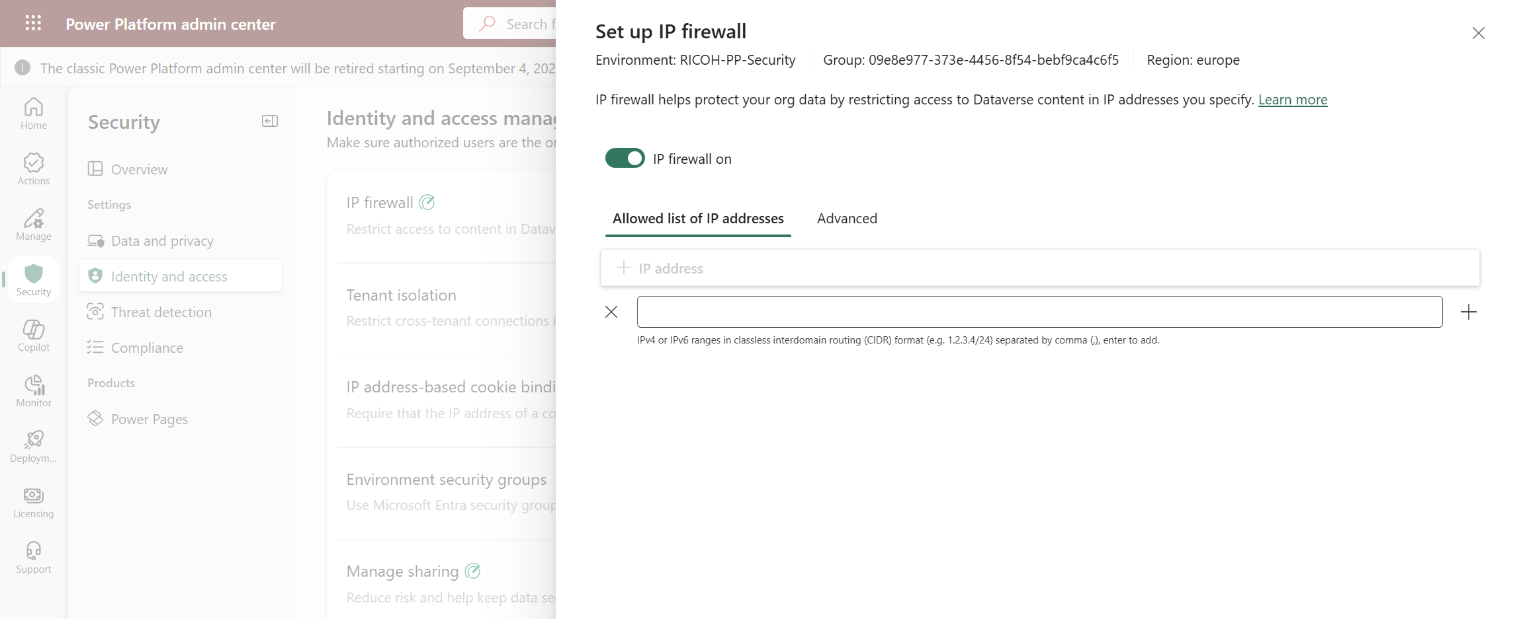
Identity & Access Management + Network Security
IP Firewall for an environment or an environments group
IP Firewall
2
IP Firewall enabled for the environment
3
Identity & Access Management
IP address or IP addresses range
1
4
#CollabDaysBE2025

Slide 24
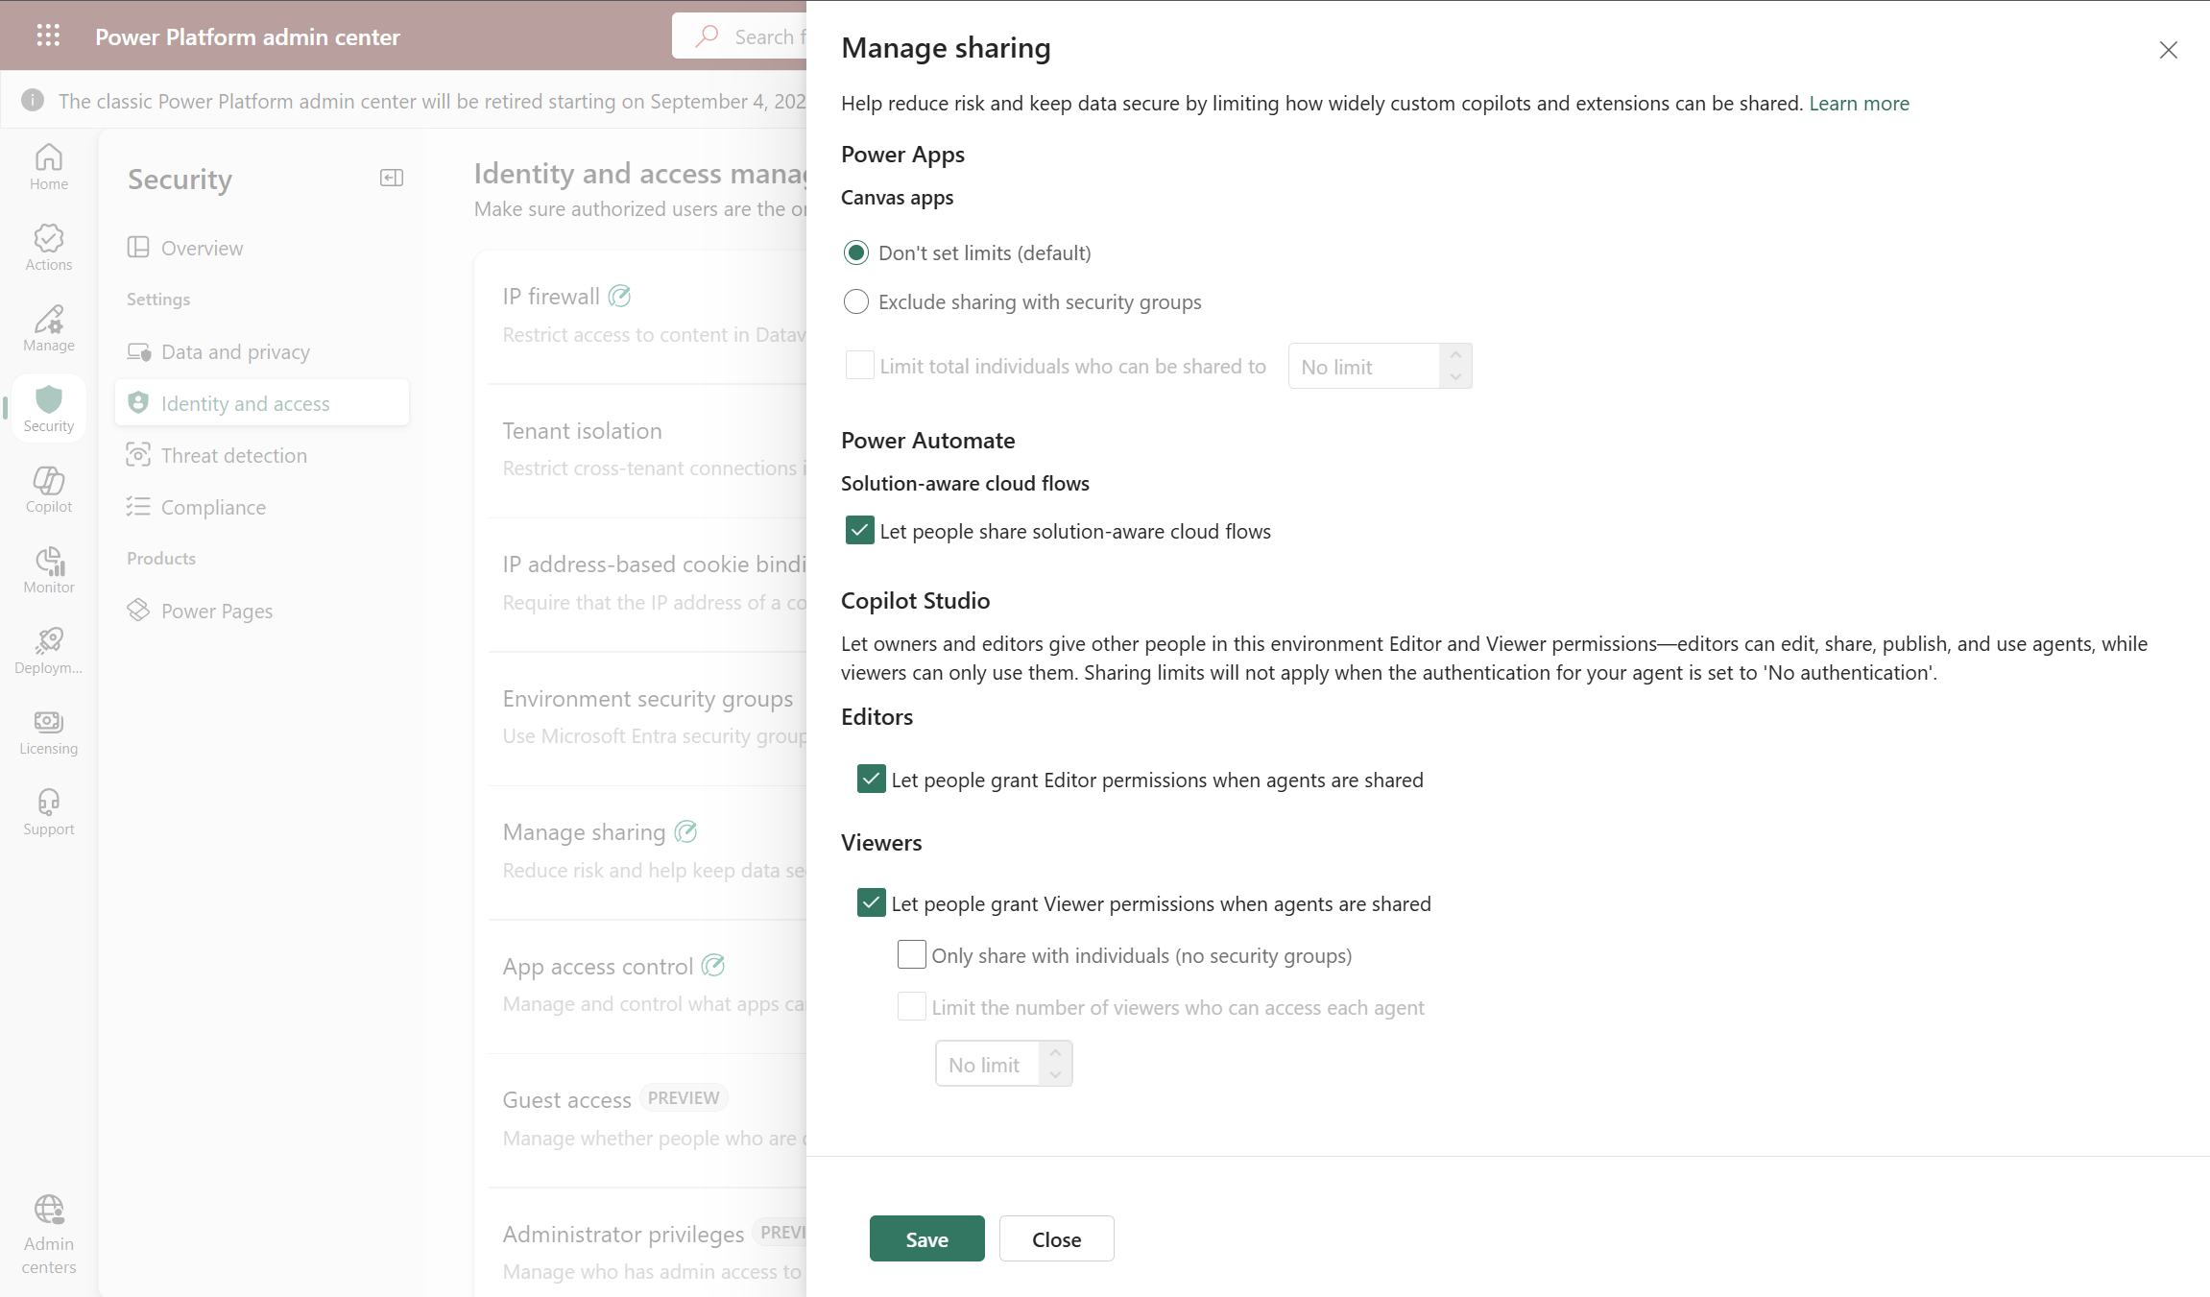
Identity & Access Management + Network Security
Limit sharing - Power Platform | Microsoft Learn – For an environment or an environments group
Canvas Apps Sharing settings
3
Identity & Access Settings
Power Automate Sharing settings
4
1
Copilot Studio Sharing settings
5
Manage sharing setting
2
#CollabDaysBE2025

Slide 25
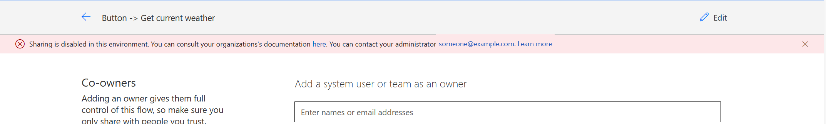
Identity & Access Management + Network Security
Impact of sharing settings when someone tries to share an App and Sharing has been disabled in an environment
#CollabDaysBE2025

Slide 26
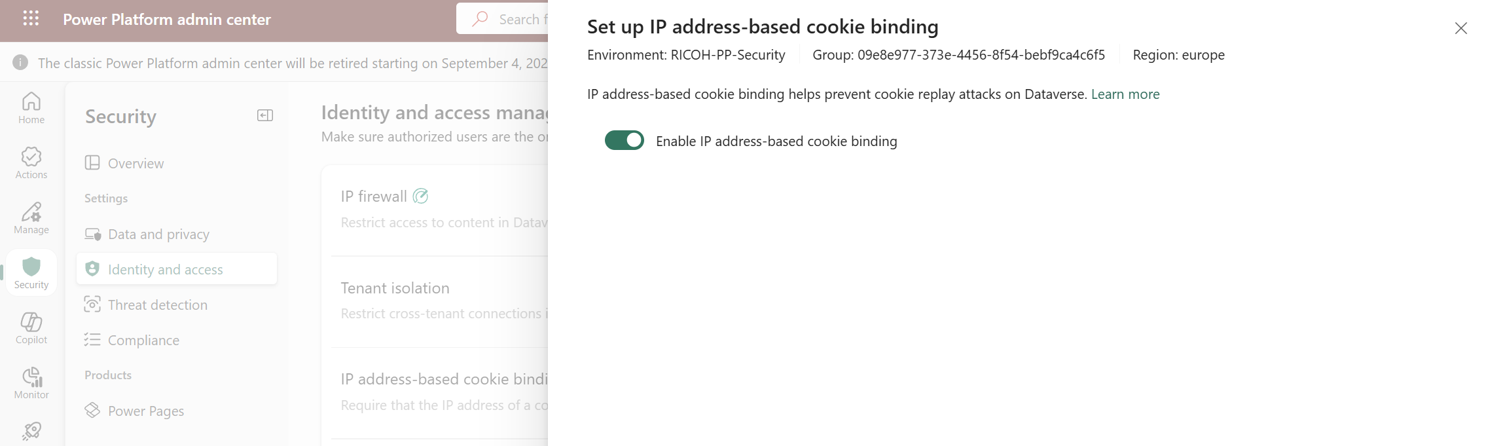
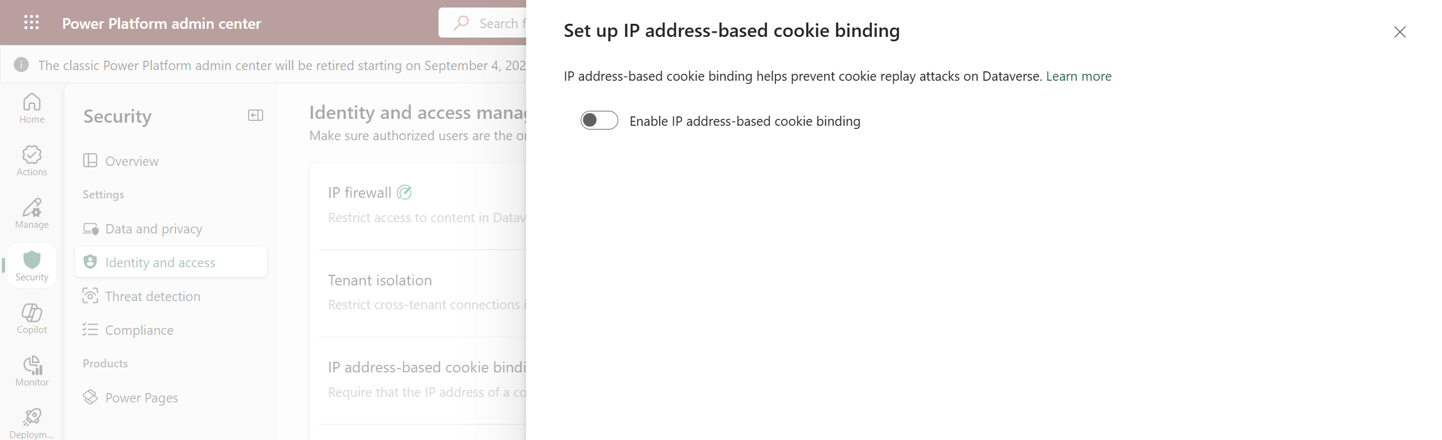
Identity & Access Management + Network Security
Limit Safeguarding Dataverse sessions with IP cookie binding - Power Platform | Microsoft Learn – For an environment or an environments group
Enable/Disable IP address cookie binding
3
Identity & Access Settings
1
IP-address cookie binding
2
#CollabDaysBE2025

Slide 27
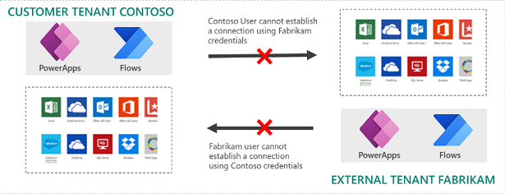
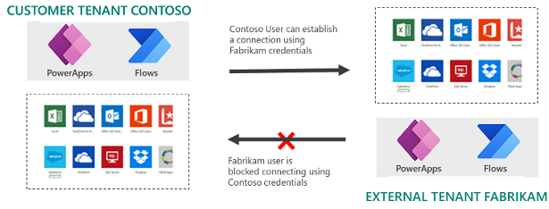
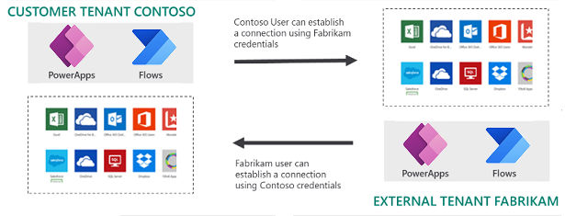
Identity & Access Management + Network Security
Limit Restrict cross-tenant inbound and outbound access - Power Platform | Microsoft Learn – Tenant isolation scenarios
#CollabDaysBE2025

Slide 28
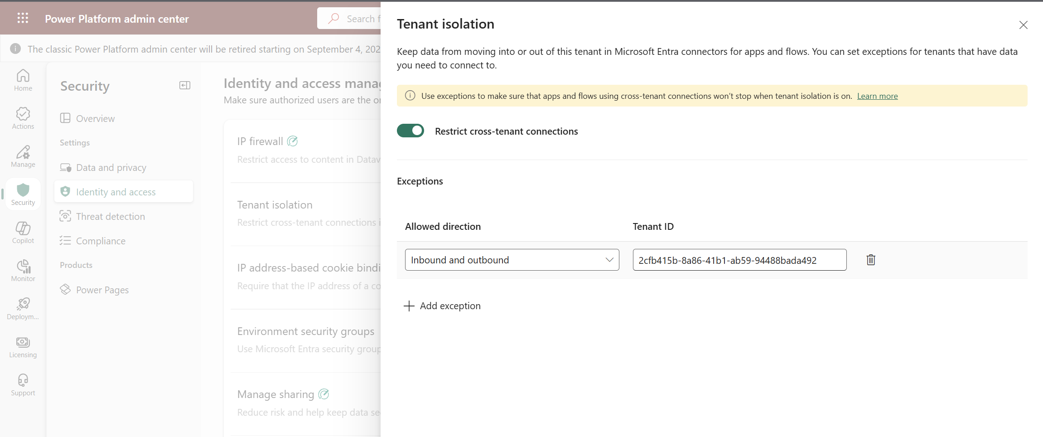
Identity & Access Management + Network Security
Limit Restrict cross-tenant inbound and outbound access - Power Platform | Microsoft Learn – Tenant isolation scenarios
Tenant Isolation enabled in the tenant
2
Identity and access settings
1
Exceptions can be configured in 1 way or 2 ways
3
#CollabDaysBE2025

Slide 29
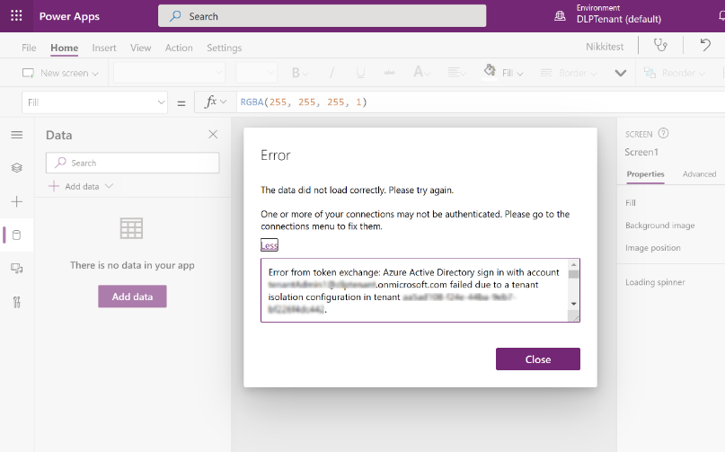
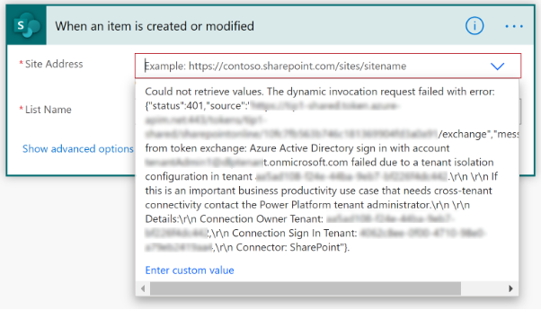
Identity & Access Management + Network Security
Limit Restrict cross-tenant inbound and outbound access - Power Platform | Microsoft Learn – Impact on Apps & Flows
#CollabDaysBE2025
Notes:
IP Firewall: Environment Level vs. Environment Group Level
Manage Sharing: Environment vs. Environment Group Level
IP Cookie Binding
Tenant Isolation

Slide 30
Demo #3: Identity & Access Management – Part I
#CollabDaysBE2025
Notes:
IP Firewall: Environment Level vs. Environment Group Level
Manage Sharing: Environment vs. Environment Group Level
IP Cookie Binding
Tenant Isolation

Slide 31
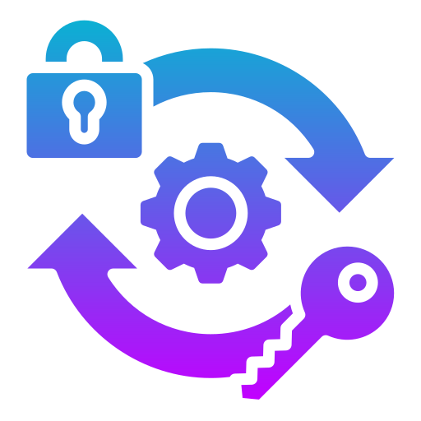
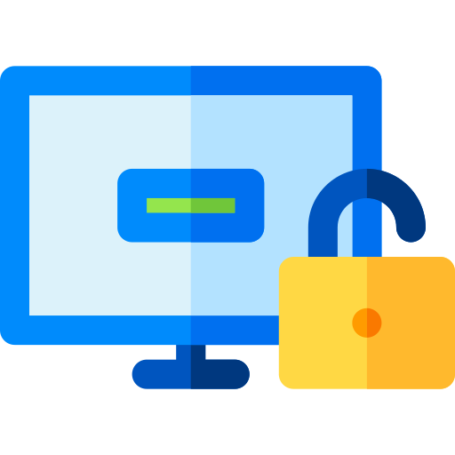


Identity & Access Management + Network Security
Ensure that only authorized users can access specific resources
Enforce on-demand, just-in-time administrative access when needed
Minimize number of privileged users (admins) and duration of access
Reduce risks of authorized user impact on sensitive data / malicious user getting access
Prevents malicious users from using unapproved apps to export sensitive data
Allows to control which Apps can run in a Dataverse environment
Enable/Block access to the Power Platform enforcing organization policies regarding user/group membership, IP location, device, risk detection, etc.
Enable/Block Guest access to Power Platform environments
Disable anonymous access for Agents
Control over where Agents can be published
Privilege Identity Management
App Access Control
Conditional Access + Guest Access
Agent Authentication + Access
#CollabDaysBE2025
Notes:
Identity and access management: Ensure that only authorized users can access specific resources, through features such as IP firewall, IP cookie binding, Manage sharing, conditional access policies for individual apps, managed identities for Dataverse plug-ins, and privileged access.
Identity & Acces Management + Network Security: IP Firewall | Resource sharing limits | IP cookie binding | Tenant Isolationt | PIM | Client app Access | Conditional Access for Individual Canvas Apps | Agent Access & Authentication
Privileged Identity Management:
Enforce on-demand, just-in-time administrative access when needed
Minimize number of privileged users (admins) and duration of access
Reduce risks of authorized user impact on sensitive data / malicious user getting access
App Access Control: The app access control feature applies only to Managed Environments. It prevents data exfiltration by controlling which apps are allowed and blocked in each environment. Learn more in Control which apps are allowed in your environment.
Agent Controls:
Use new governance controls to limit agent sharing, turn off anonymous access, enforce preferred authentication providers, and provide better security. These controls help reduce the risks of data exfiltration, ensure agent development meets all organizational governance requirements, and proactively reduce security risks.
Agent Authentication: This feature allows administrators to configure authentication for all agent interactions in the environment.
Agent Access: This feature gives administrators control over where agents can be published, allowing customer engagement across multiple platforms. Admins can select multiple available channels, such as Microsoft Teams, Direct Line, Facebook, Dynamics 365 for Customer Service, SharePoint, and WhatsApp.

Slide 32
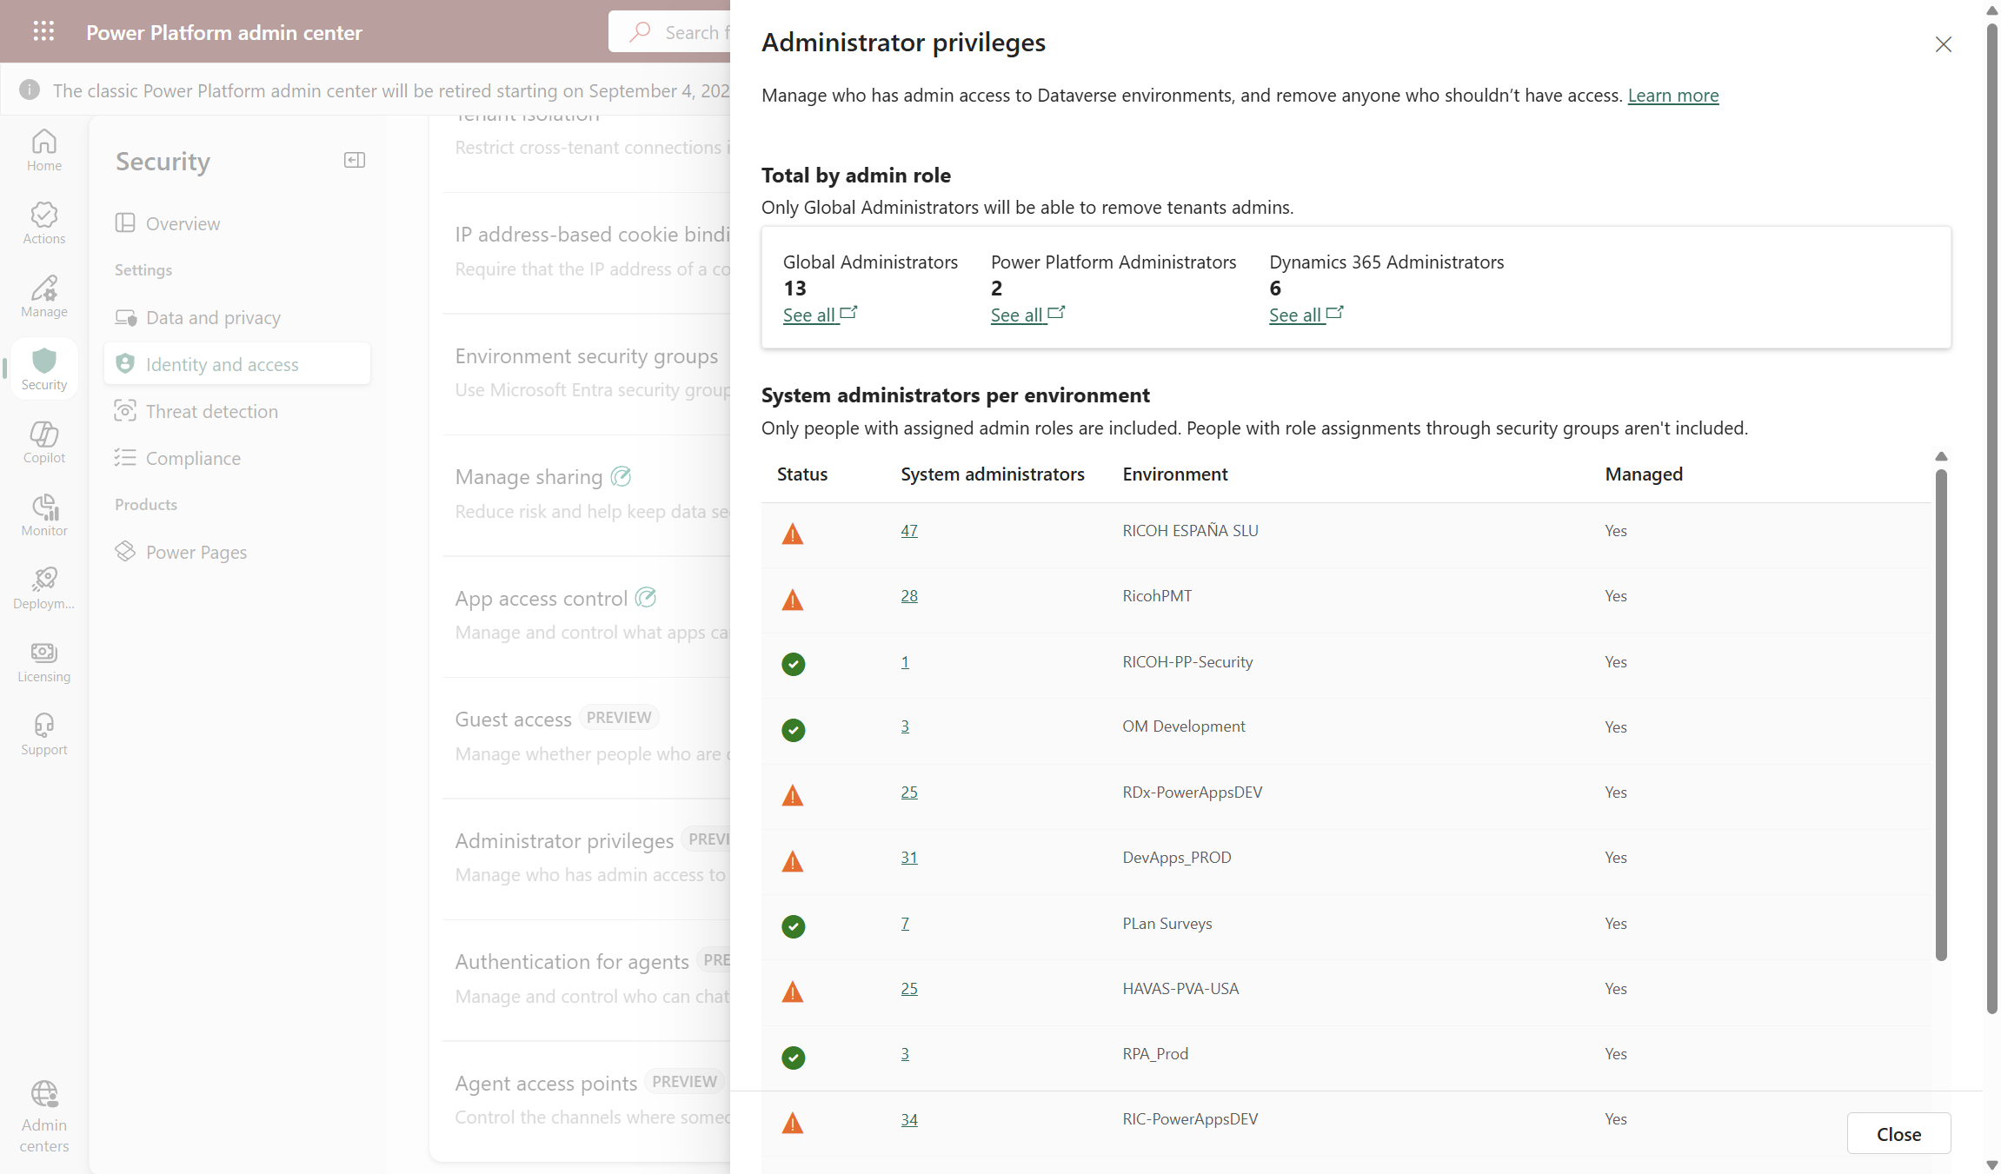
Identity & Access Management + Network Security
Review privileged access to Power Platform environments (Preview)
Administrator privileges posture
Identity & Access Settings
3
1
Administrator privileges setting
2
#CollabDaysBE2025

Slide 33
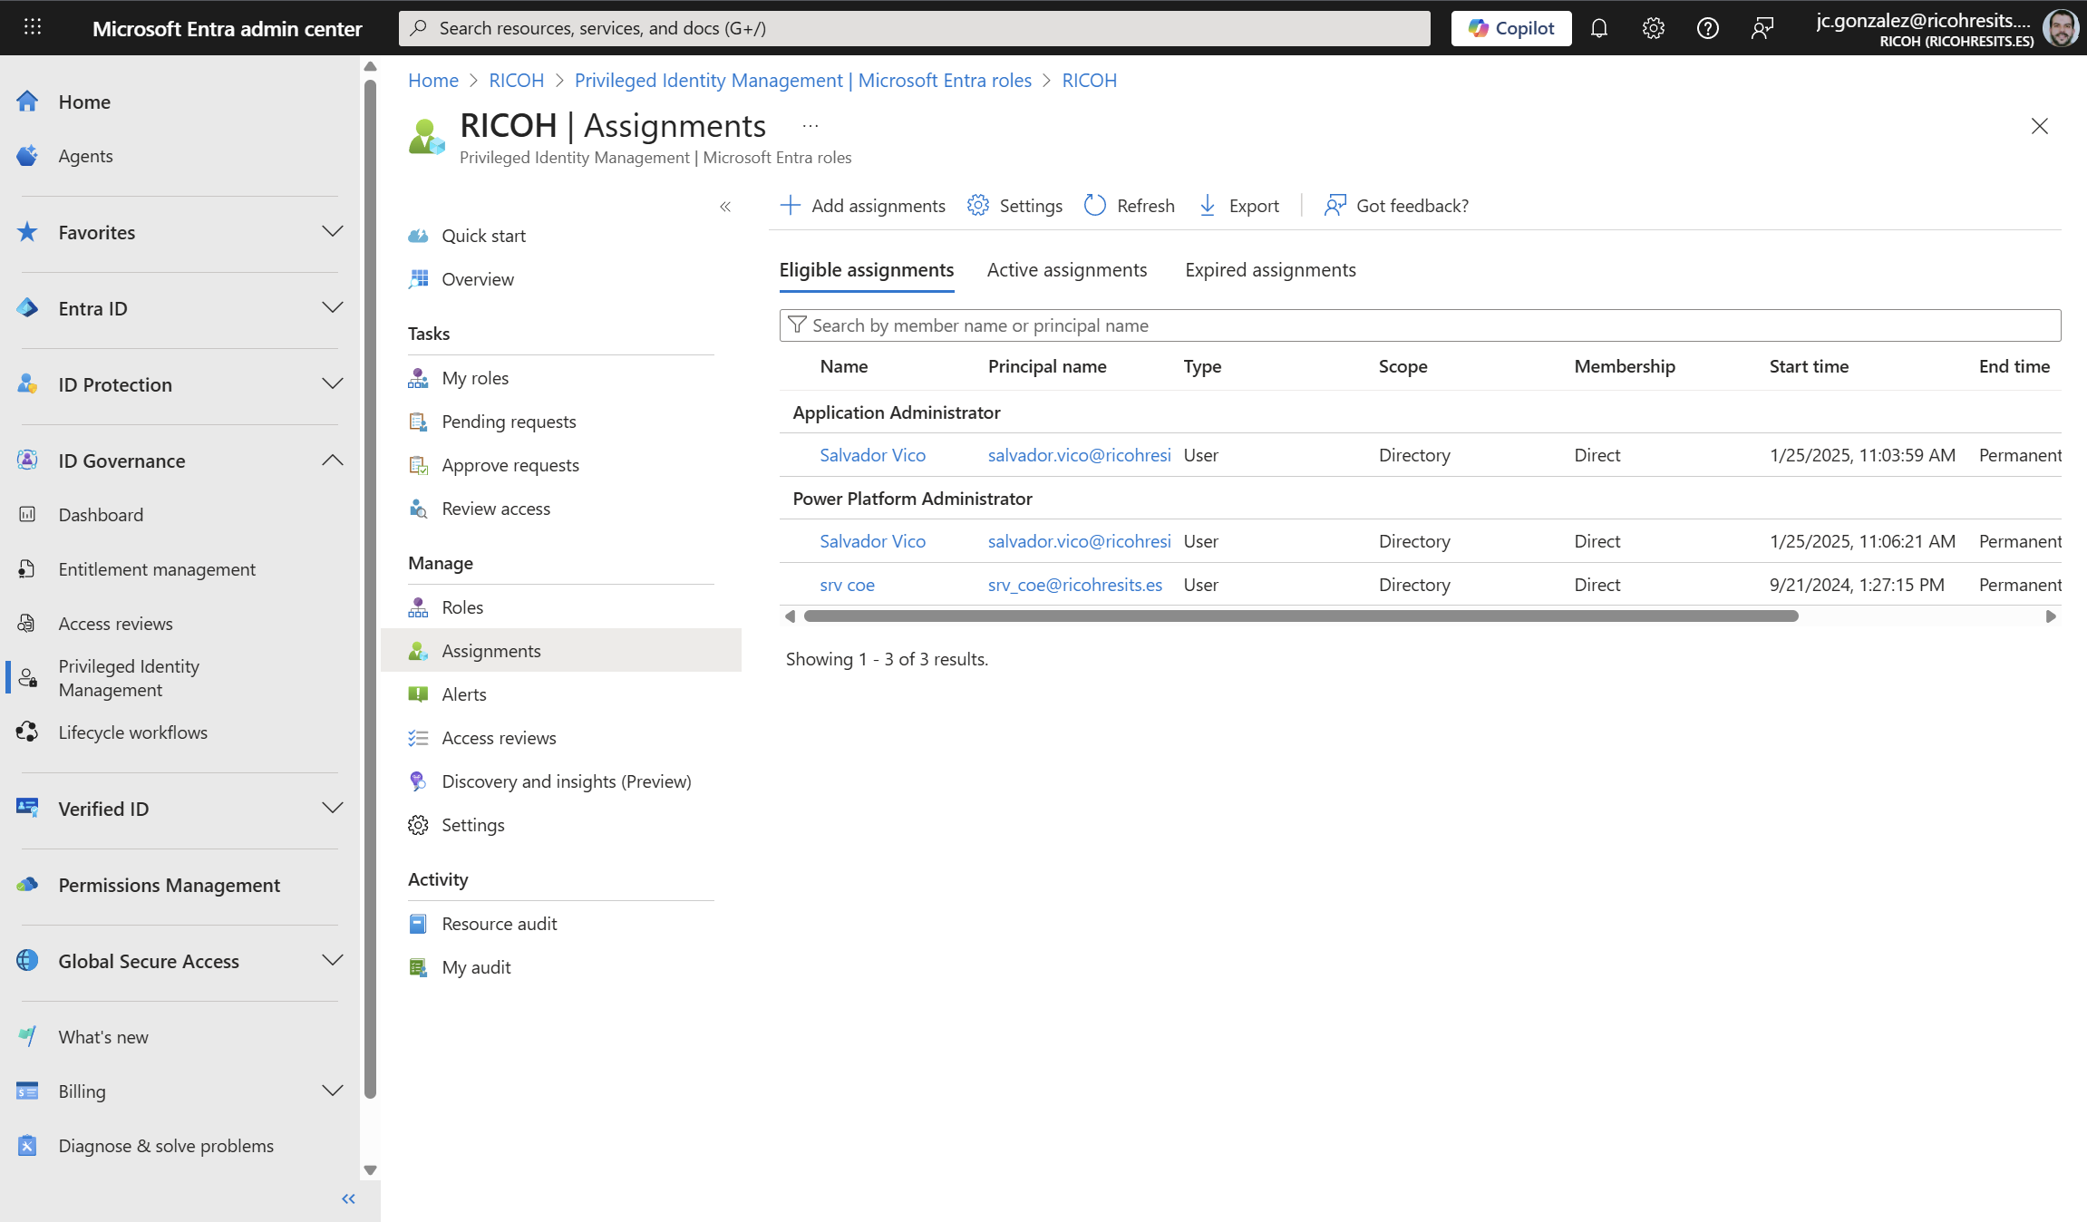
Identity & Access Management + Network Security
Use Entra Privileged Identity Management in Power Platform admin center to manage high-privileged admin roles - Power Platform | Microsoft Learn - Be aware of current limitations when using PIM with PP Admin roles
Eligible Power Platform Admin Role assignments
System Admin Role in environments is not granted!
#CollabDaysBE2025
Notes:
Microsoft no longer automatically assigns the System Administrator role to users with global or service level admin roles such as Power Platform Administrator and Dynamics 365 Administrator.
These admins can continue to sign in, to the Power Platform admin center, with these privileges:
Enable or disable tenant level settings
View analytics information for environments
View capacity consumption
These admins can't perform activities that require direct access to Dataverse data without a license. Examples of these activities include:
Updating the security role for a user in an environment
Installing apps for an environment

Slide 34
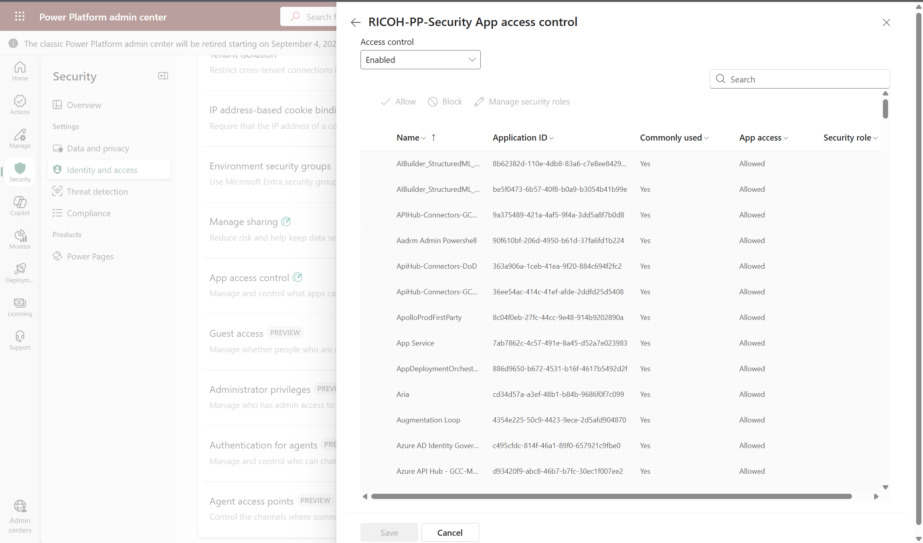
Identity & Access Management + Network Security
Control which apps are allowed in your environment - Power Platform | Microsoft Learn
Allow / Block Apps Access to the environment
3
Identity & Access Settings
1
App access control setting
2
#CollabDaysBE2025

Slide 35
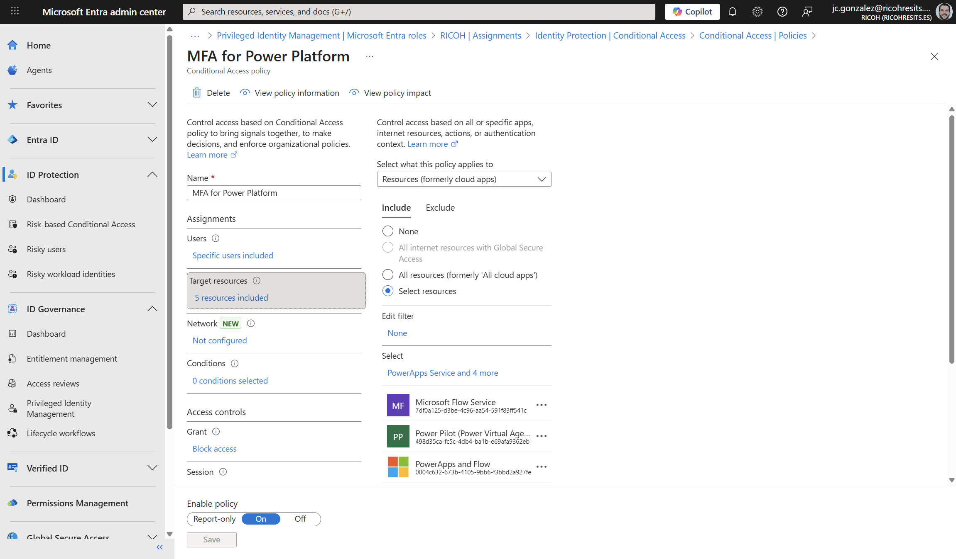
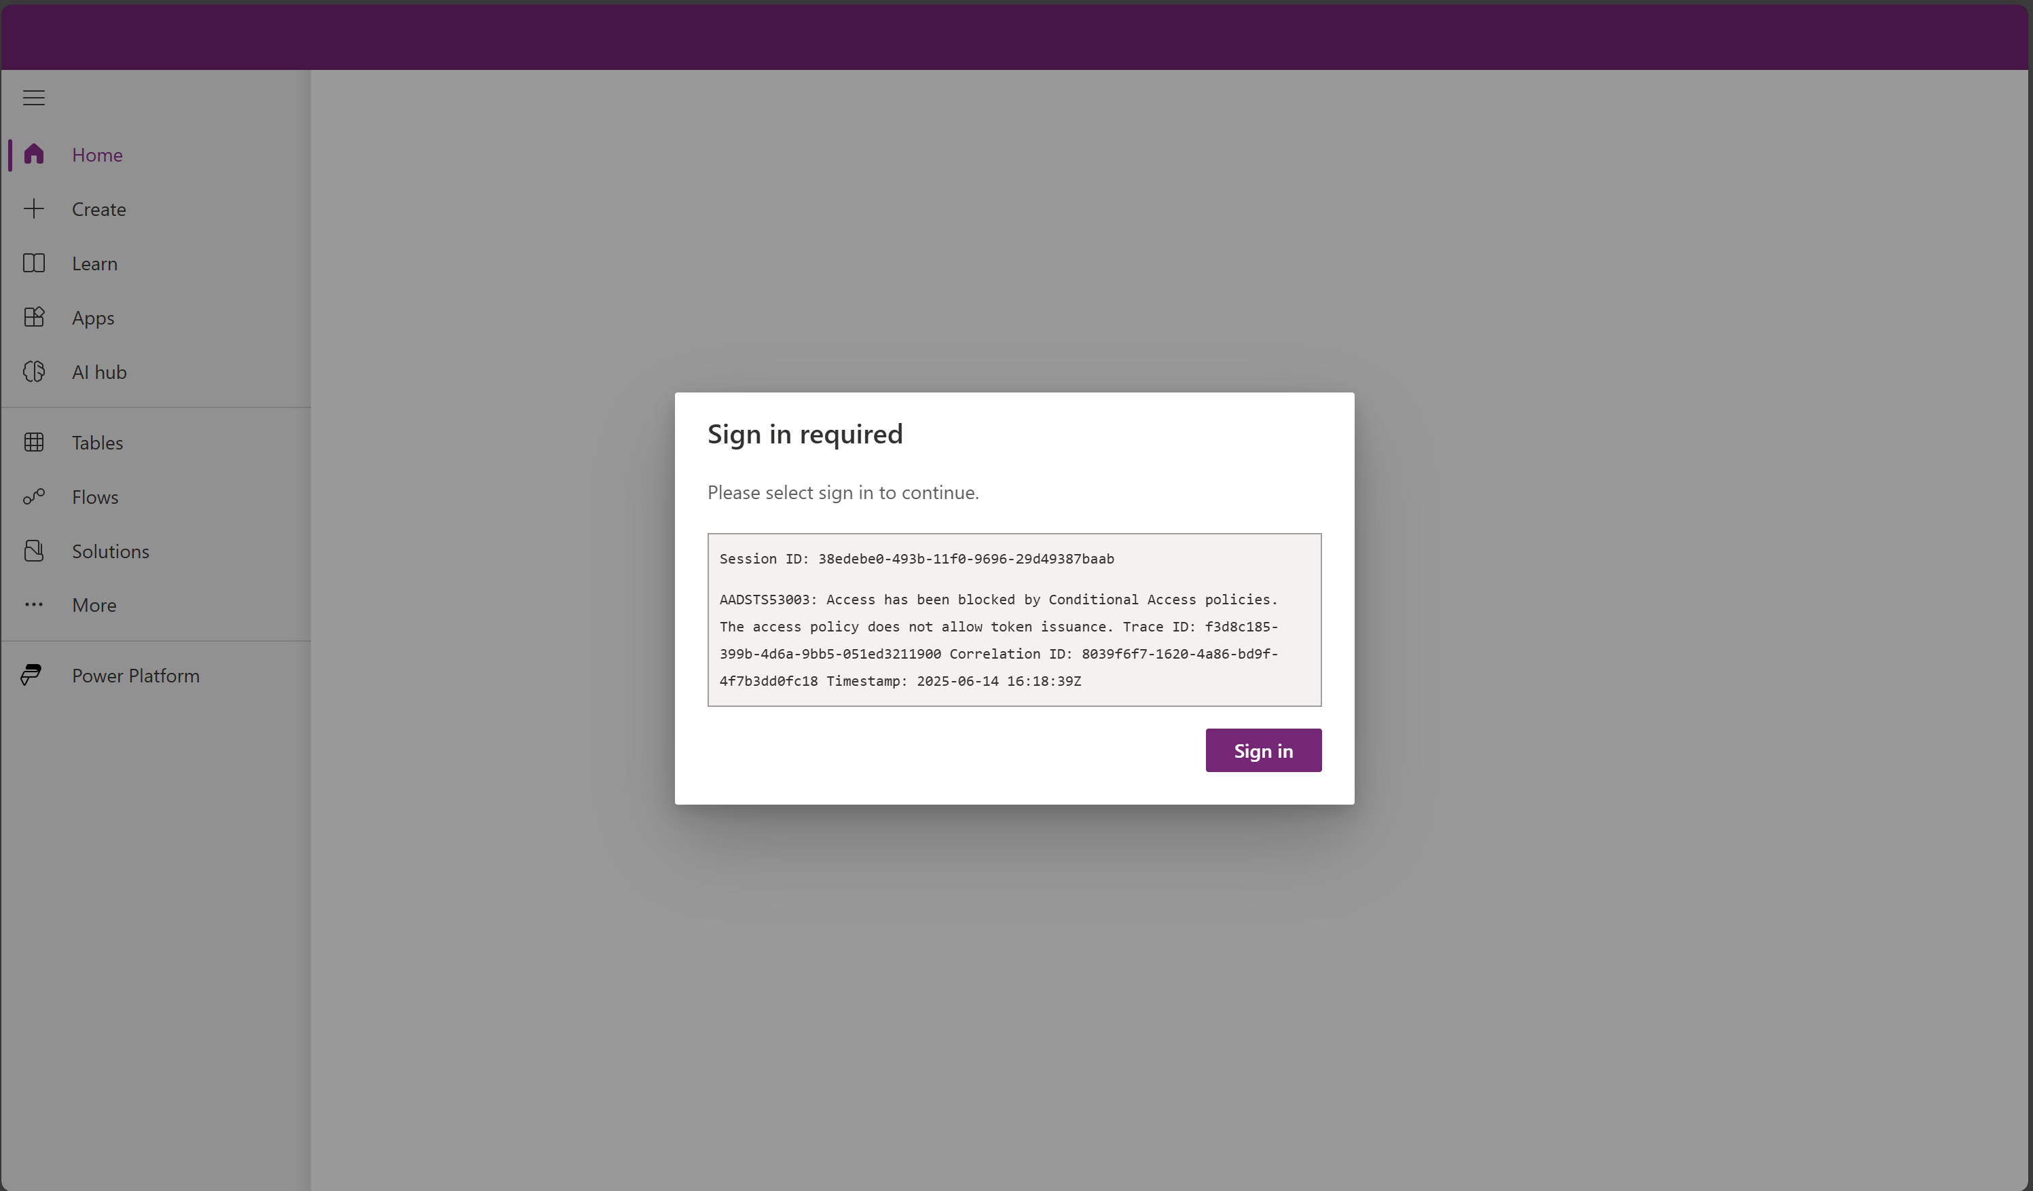
Identity & Access Management + Network Security
Block access by location with Microsoft Entra Conditional Access - Power Platform | Microsoft Learn
User Experience for Power Apps
2
Conditional Access for the Power Platform
1
#CollabDaysBE2025

Slide 36
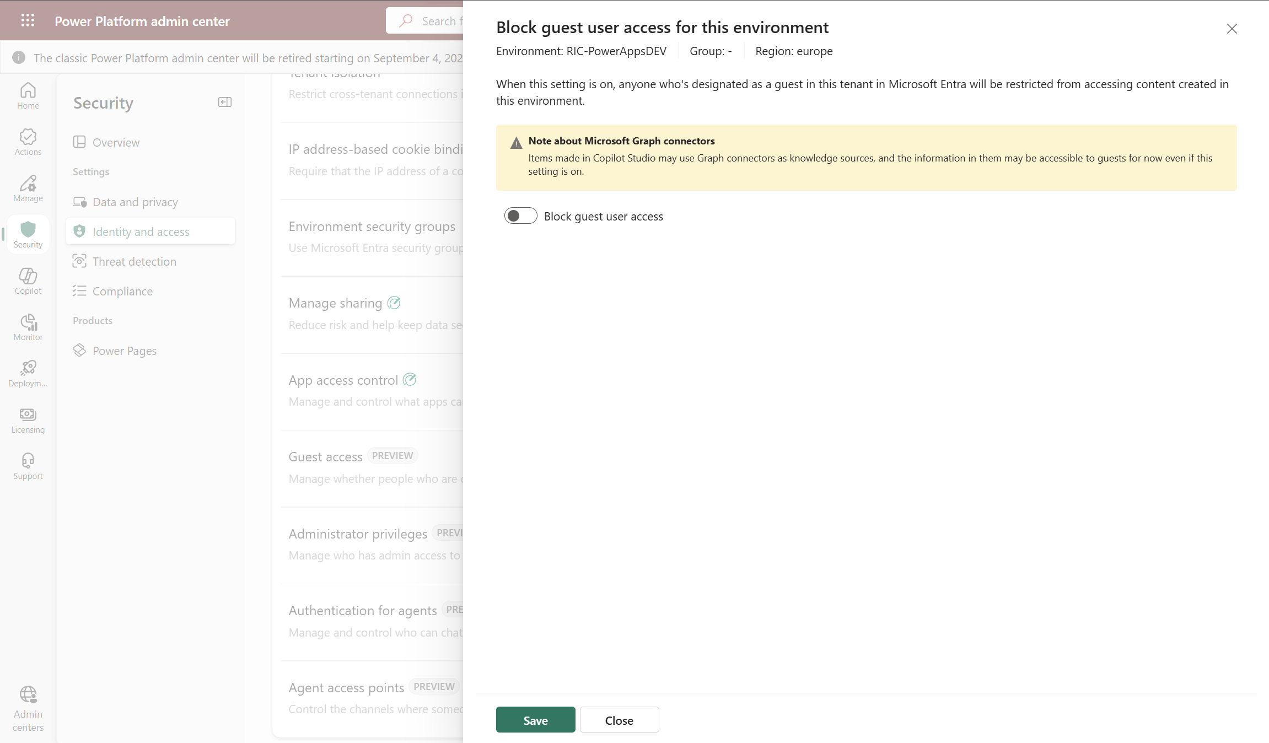
Identity & Access Management + Network Security
Permit or deny guest access to an environment | Microsoft Learn – A better alternative to the use of Conditional Access Policies!!
Identity & Access Settings
Enable/Disable guest user access to the environment
3
1
Guest access setting
2
#CollabDaysBE2025
Notes:
When an admin configures this environment setting, guests can't connect to data sources in the environment. Guests can't perform any maker actions, and they can't use any apps or flows shared with them. Admins implement this security within the Power Platform admin center without using controls like conditional access or continuous access evaluation.

Slide 37
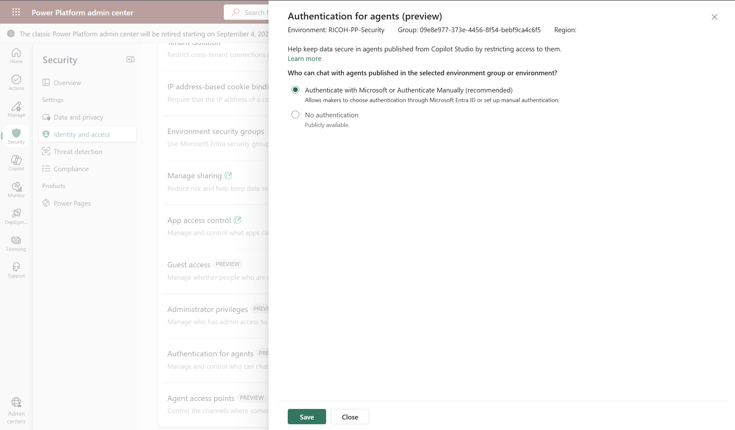
Identity & Access Management + Network Security
Manage agent security with enhanced admin controls | Microsoft Learn – Agent authentication: It can be configured for an environment or a environments group
Authentication agents settings
Identity & Access Settings
3
1
Authentication for agents
2
#CollabDaysBE2025
Notes:
This feature allows administrators to configure authentication for all agent interactions in the environment. Admins can select one of the following options:
Authenticate with Microsoft or Authenticate Manually allows you to force authentication through Microsoft Entra ID or authenticate manually. This helps prevent makers from creating or using agents with no authentication.
No authentication allows anonymous access.

Slide 38
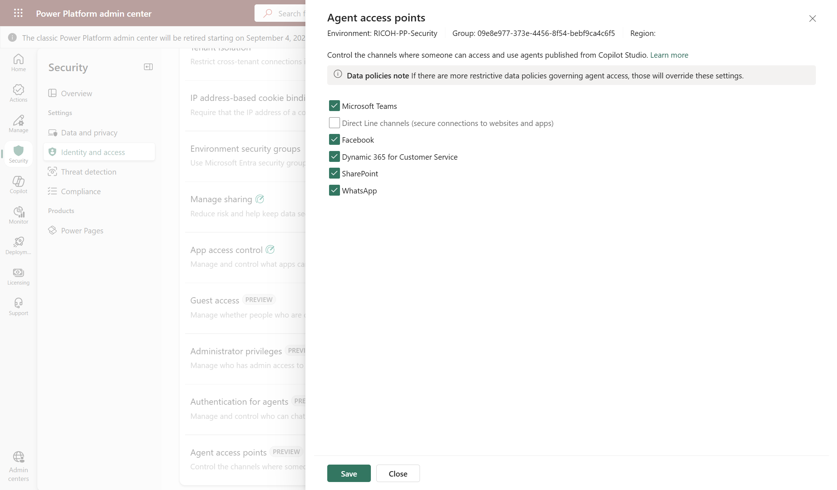
Identity & Access Management + Network Security
Manage agent security with enhanced admin controls | Microsoft Learn – Agent access points: : It can be configured for an environment or a environments group
Identity & Access Settings
Channels where agents are available
3
1
Agent Access points
2
#CollabDaysBE2025
Notes:
This feature gives administrators control over where agents can be published, allowing customer engagement across multiple platforms. Admins can select multiple available channels, such as Microsoft Teams, Direct Line, Facebook, Dynamics 365 for Customer Service, SharePoint, and WhatsApp.

Slide 39
Demo #4: Identity & Access Management – Part II
#CollabDaysBE2025
Notes:
PIM
Block/Enable Client Access App
Conditional Access + Guest Access
Agents Authentication + Agent Access

Slide 40



Compliance & Auditing
Implement robust compliance measures to safeguard organizational data and ensure adherence to industry regulations
Extends JIT access to the Power Platform with customer approval
Bound to specific environment, user and duration
OOB audit available to end user
Tenant home geo default
Multi-geo support (at environment level) to enable global presence
Data residency ensured within geo
National, regional and industry-specific regulations for data collection and use
E.g., FedRamp, FERPA, HIPAA, SOC, IRS 1075, SEC Regulation, FISC (Japan), FACT (UK), etc
GDPR compliant
Microsoft Trust Center
Customer Lockbox
Data Residency
Compliance Standards
Data Privacy
#CollabDaysBE2025
Notes:
Customer Lockbox
Extendss JIT with customer approval
Bound to specific environment, user and duration
OOB audit available to end user
Data residency
Tenant home geo default
Multi-geo support (at environment level) to enable global presence
Data resiliency ensured within geo
Compliance standards
National, regional and industry-specific regulations for data collection and use
E.g., FedRamp, FERPA, HIPAA, SOC, IRS 1075, SEC Regulation, FISC (Japan), FACT (UK), etc.
Data Privacy
GDPR compliant
Microsoft Trust Center

Slide 41
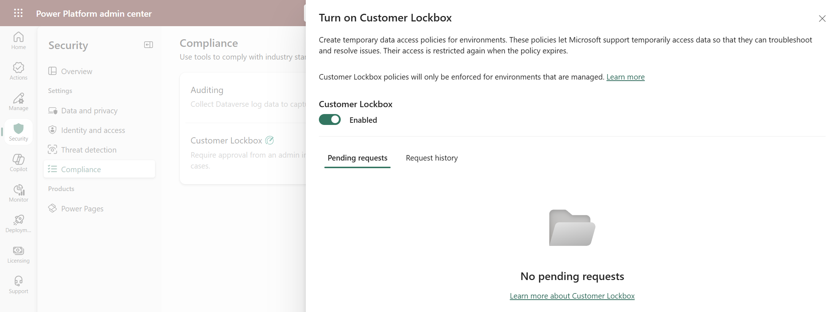
Compliance & Auditing
Securely access customer data using Customer Lockbox in Power Platform and Dynamics 365 - Power Platform | Microsoft Learn
Enable/Disable Customer Lockbox
3
Access to Customer Lockbox
2
Access Compliance settings
1
#CollabDaysBE2025
Notes:
Customer Lockbox
Extends JIT with customer approval
Bound to specific environment, user and duration
OOB audit available to end user
Data residency
Tenant home geo default
Multi-geo support (at environment level) to enable global presence
Data resiliency ensured within geo
Compliance standards
National, regional and industry-specific regulations for data collection and use
E.g., FedRamp, FERPA, HIPAA, SOC, IRS 1075, SEC Regulation, FISC (Japan), FACT (UK), etc.
Data Privacy
GDPR compliant
Microsoft Trust Center

Slide 42




Compliance & Auditing
Implement robust compliance measures to safeguard organizational data and ensure adherence to industry regulations
Everything is audited in the PP!
User access and activity (records changes)
Monitor system jobs
Audit deleted jobs
Manage log records
Dataverse, Power Apps, Power Automate, Connectors, Data Activity
Internal and external audit
Audit changes to records and user access
Activities performed on Environments by the Power Platform Administrator
Lifecycle operations, property and setting change activities, security and permission change activities
Dataverse Audit
Activity Logging
Admin Activity Logging
Capture, record, discover and retain your organization's unified audit log
Microsoft Purview Audit
#CollabDaysBE2025
Notes:
Customer Lockbox
Extendss JIT with customer approval
Bound to specific environment, user and duration
OOB audit available to end user
Data residency
Tenant home geo default
Multi-geo support (at environment level) to enable global presence
Data resiliency ensured within geo
Compliance standards
National, regional and industry-specific regulations for data collection and use
E.g., FedRamp, FERPA, HIPAA, SOC, IRS 1075, SEC Regulation, FISC (Japan), FACT (UK), etc.
Data Privacy
GDPR compliant
Microsoft Trust Center

Slide 43
Demo #5: Compliance & Auditing
#CollabDaysBE2025
Notes:
Customer Lockbox
Dataverse Audit
Purview Audit

Slide 44




Threat Detection & Protection
Proactively protect your organizational assets in the Power Platform through threat detection and remediation
Comprehensive static analysis of your solution objects against a set of best practice rules
Identify problematic patterns in solution components and receive detailed reports that highlight issues
Available for managed environments
Monitor and detect suspicious or malicious activities in your Power Platform environment
Intelligent detection and responses to suspicious activities, such as mass data deletion or unauthorized app execution
Monitor agents' capabilities and security by means of an external threads detection system
If the system detects any suspicious tools or actions, it can intervene to block them from executing
External Systems: Custom | Microsoft Defender | 3 Party
Monitors agent behavior in your tenant and helps detect cross-domain prompt injection attacks (XPIA) in real time
Messages inspection before the Agent takes any action, and blocking them if they are suspicious
Solution Checker
Microsoft Sentinel Integration
Thread Detection and Protection for Copilot Agents
Microsoft Defender for Copilot Agents
#CollabDaysBE2025
Notes:
Protección frente a amenazas
Threat protection: Protect your organization's assets and resources through unified detection by using Microsoft Sentinel solution for Power Platform. This solution allows for intelligent detection and responses to suspicious activities, such as mass data deletion or unauthorized app execution. In this way, it enhances your security posture and effectively mitigates potential threats.
Thread Protection: Solution Checker | Microsoft Sentinel Integration | Thread Detection for Copilot Agents | Microsoft Defender for Copilot Agents
-------------------------------------------------------------------------------------------------------------
Solution Checker: The solution checker is a powerful tool that performs a comprehensive static analysis of your solution objects against a set of best practice rules. By using solution checker, you can quickly identify problematic patterns in solution components and receive detailed reports that highlight issues, affected components, and provide links to documentation on how to resolve each issue.
Microsoft Sentinel Integration: Monitor and detect suspicious or malicious activities in your Power Platform environment. Monitor and secure your Dynamics 365 Customer Engagement environment, which uses the Microsoft Dataverse common data store known as
Thread Detection and Protection for Copilot Studio: Custom agents created in Copilot Studio are secure by default. They include built-in protection against various threats, such as user prompt-injection attacks (UPIA) and cross-domain prompt injection Attacks (XPIA). At runtime, the agent blocks attacks of these types, reducing the risk of data exfiltration.
To further increase the monitoring capabilities and security of custom agents, Copilot Studio lets organizations configure external threat detection systems for enhanced oversight. These tools operate during the agent's runtime, continuously evaluating agent activity. If the system detects any suspicious tools or actions, it can intervene to block them from executing. This threat detection provides an extra layer of real-time protection and compliance enforcement.
Microsoft Defender – Copilot Studio AI Agents: Microsoft Defender is providing new detection capabilities to secure Copilot Studio AI Agents from oversharing, misconfiguration, etc. It monitors agent behavior in your tenant and helps detect cross-domain prompt injection attacks (XPIA) in real time.

Slide 45
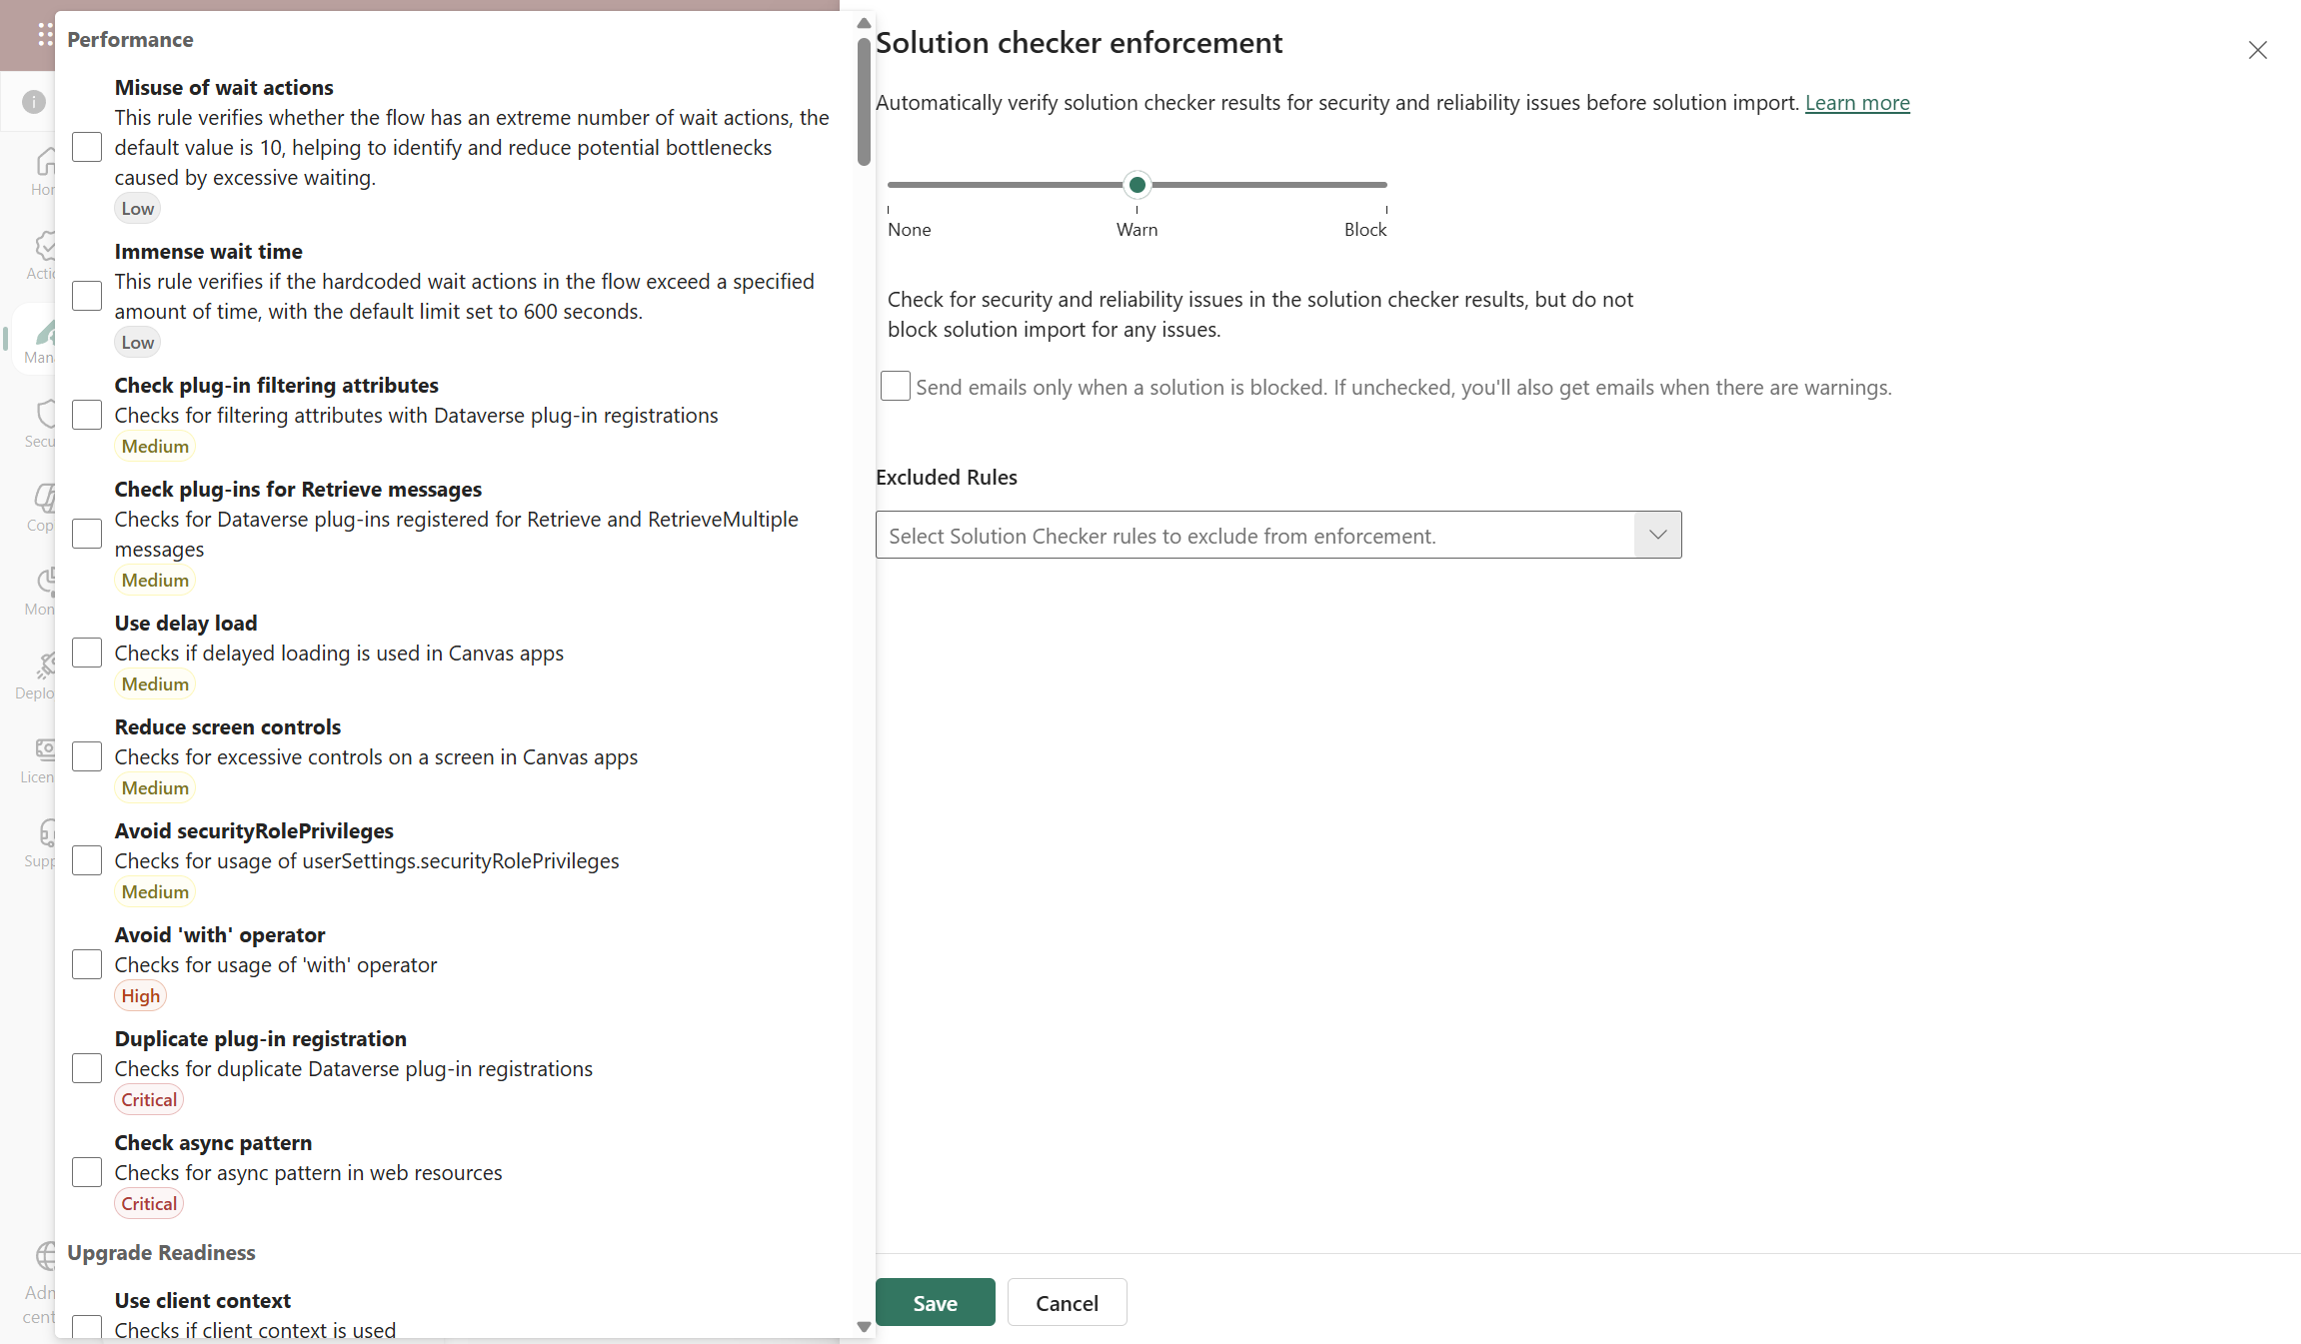
Threat Detection & Protection
Solution checker enforcement in Managed Environments - Power Platform | Microsoft Learn - For an environment or an environments group
#CollabDaysBE2025
Notes:
Solution Checker: The solution checker is a powerful tool that performs a comprehensive static analysis of your solution objects against a set of best practice rules. By using solution checker, you can quickly identify problematic patterns in solution components and receive detailed reports that highlight issues, affected components, and provide links to documentation on how to resolve each issue.

Slide 46
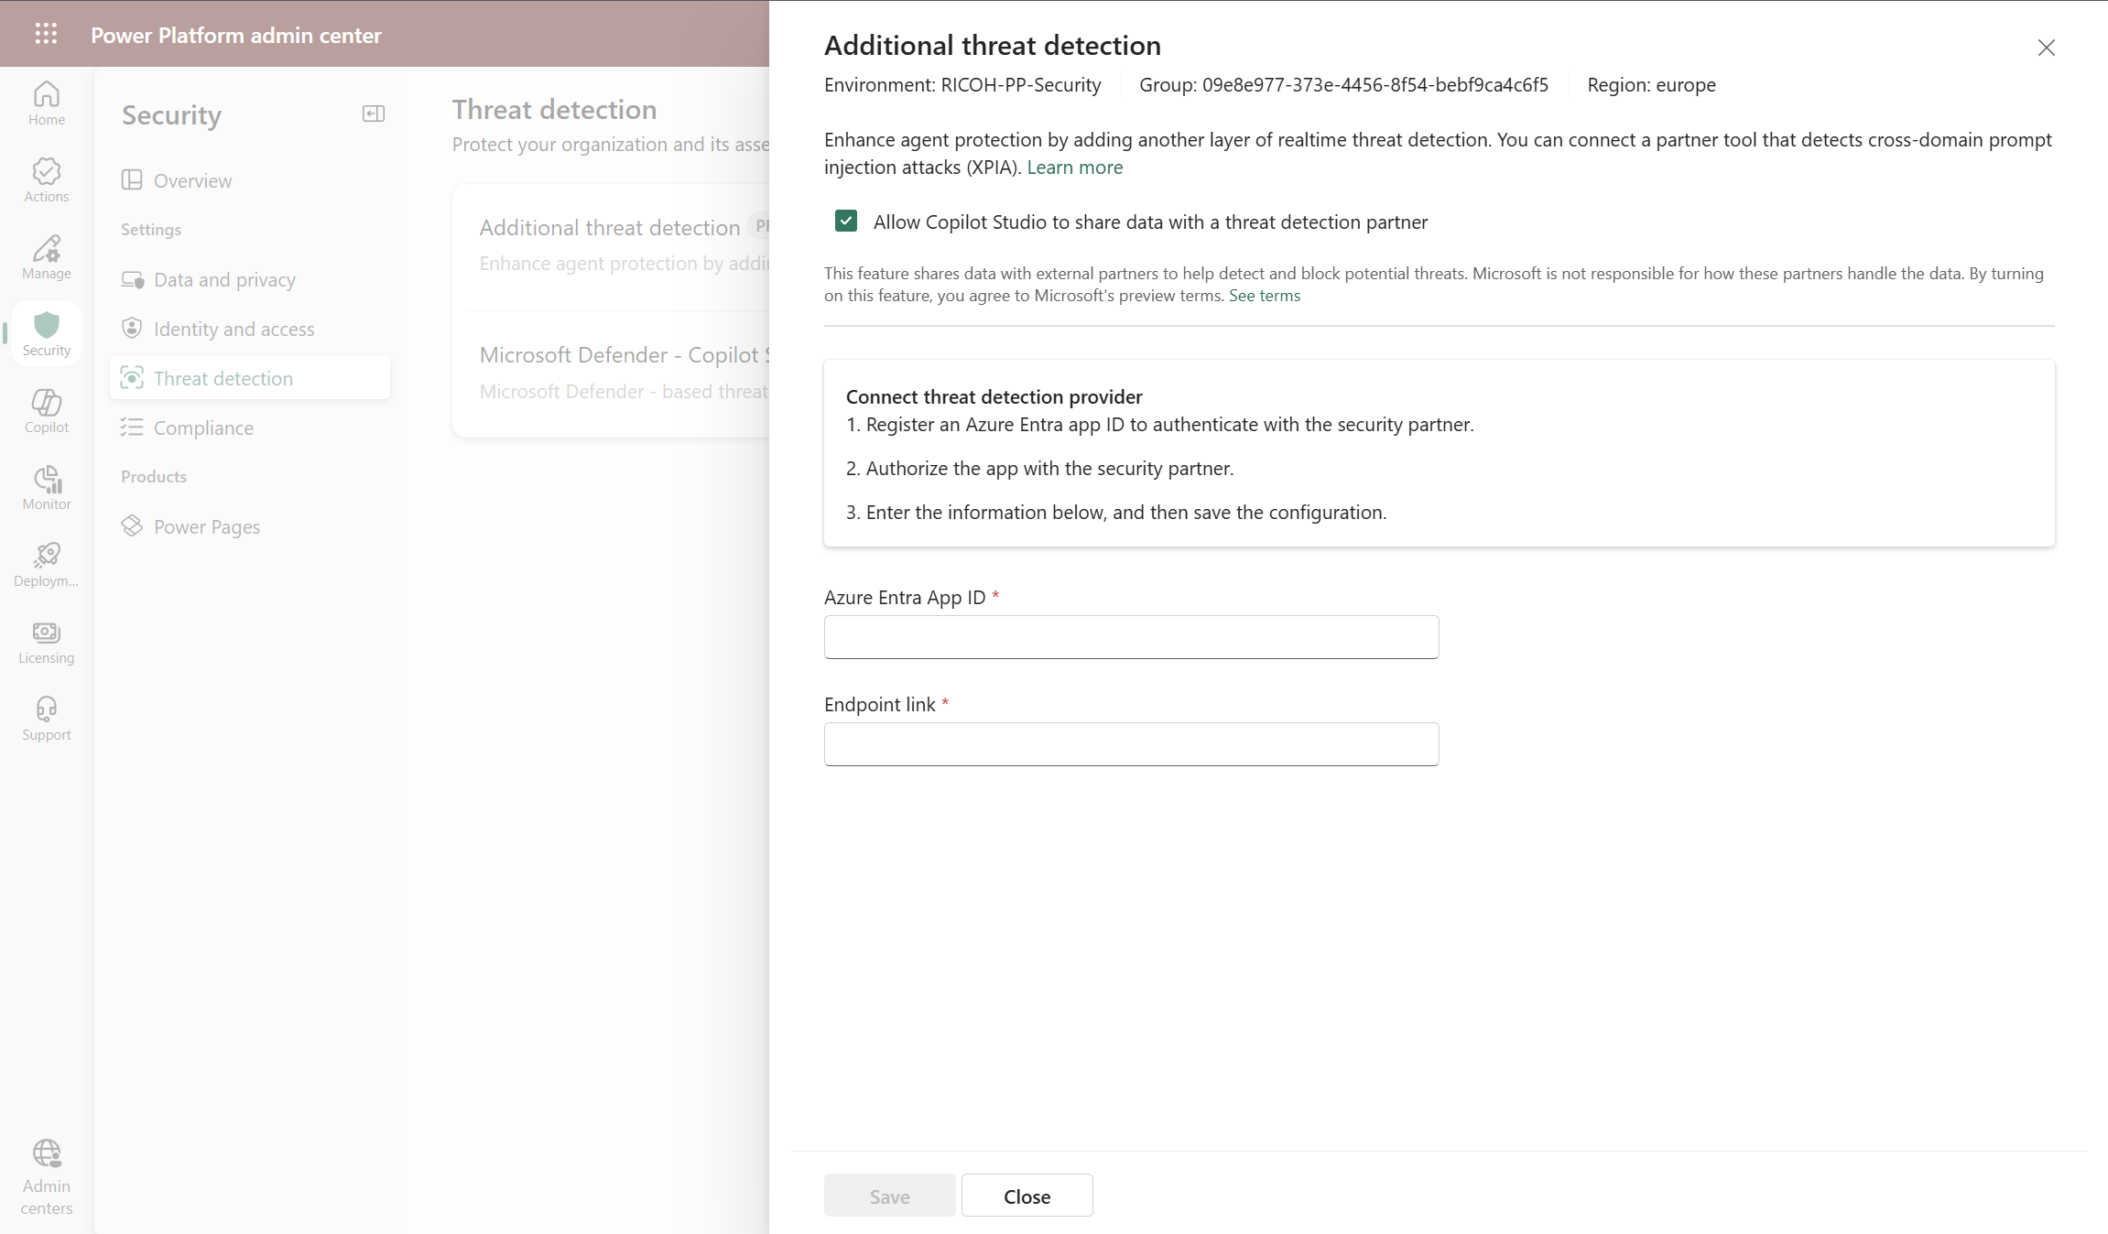
Threat Detection & Protection
Enable external threat detection and protection for Copilot Studio custom agents (preview) - Microsoft Copilot Studio | Microsoft Learn
Access to Additional Thread Detection
2
Access Thread Detection settings
1
External Thread detection system settings
3
#CollabDaysBE2025
Notes:
Thread Detection and Protection for Copilot Studio: Custom agents created in Copilot Studio are secure by default. They include built-in protection against various threats, such as user prompt-injection attacks (UPIA) and cross-domain prompt injection Attacks (XPIA). At runtime, the agent blocks attacks of these types, reducing the risk of data exfiltration.
To further increase the monitoring capabilities and security of custom agents, Copilot Studio lets organizations configure external threat detection systems for enhanced oversight. These tools operate during the agent's runtime, continuously evaluating agent activity. If the system detects any suspicious tools or actions, it can intervene to block them from executing. This threat detection provides an extra layer of real-time protection and compliance enforcement.
Copilot Studio supports a flexible "bring your own protection" approach. Organizations have the freedom to integrate security solutions that best fit their unique requirements.
Options include:
Develop your own custom monitoring tools, or have someone develop them for you. For more information on how to set up the system endpoint so that your agent can connect to it, see Build a runtime threat detection system for Copilot Studio agents
Apply a robust enterprise solution by Microsoft Defender
Use products from other trusted security providers

Slide 47
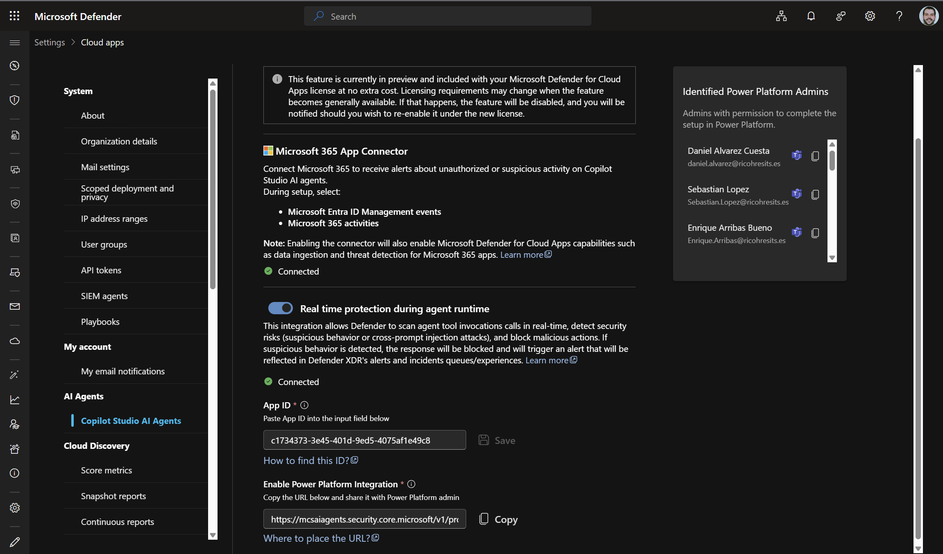
Threat Detection & Protection
Enable external threat detection and protection for Copilot Studio custom agents (preview) - Microsoft Copilot Studio | Microsoft Learn
Enable Real time protection for agents in runtime
2
Settings -> Copilot Studio AI Agents
Power Apps integration settings
3
1
#CollabDaysBE2025
Notes:
Thread Detection and Protection for Copilot Studio: Custom agents created in Copilot Studio are secure by default. They include built-in protection against various threats, such as user prompt-injection attacks (UPIA) and cross-domain prompt injection Attacks (XPIA). At runtime, the agent blocks attacks of these types, reducing the risk of data exfiltration.
To further increase the monitoring capabilities and security of custom agents, Copilot Studio lets organizations configure external threat detection systems for enhanced oversight. These tools operate during the agent's runtime, continuously evaluating agent activity. If the system detects any suspicious tools or actions, it can intervene to block them from executing. This threat detection provides an extra layer of real-time protection and compliance enforcement.
Copilot Studio supports a flexible "bring your own protection" approach. Organizations have the freedom to integrate security solutions that best fit their unique requirements.
Options include:
Develop your own custom monitoring tools, or have someone develop them for you. For more information on how to set up the system endpoint so that your agent can connect to it, see Build a runtime threat detection system for Copilot Studio agents
Apply a robust enterprise solution by Microsoft Defender
Use products from other trusted security providers

Slide 48
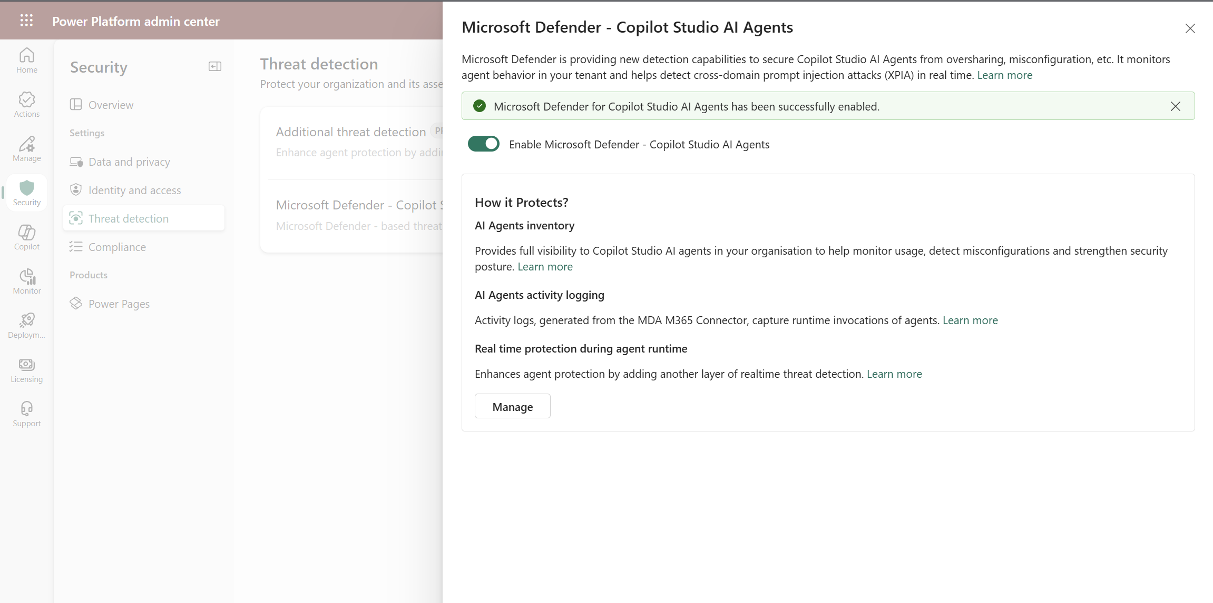
Threat Detection & Protection
Enable external threat detection and protection for Copilot Studio custom agents (preview) - Microsoft Copilot Studio | Microsoft Learn
Access to Microsoft Defender – Copilot Studio
2
Enable Microsoft Defender for Copilot Studio Agents
3
Access Thread Detection settings
1
#CollabDaysBE2025
Notes:
Thread Detection and Protection for Copilot Studio: Custom agents created in Copilot Studio are secure by default. They include built-in protection against various threats, such as user prompt-injection attacks (UPIA) and cross-domain prompt injection Attacks (XPIA). At runtime, the agent blocks attacks of these types, reducing the risk of data exfiltration.
Real-time protection during agent runtime in Microsoft Defender reduces these risks by inspecting user messages before the agent runs any actions.
If Microsoft Defender determines that a prompt is suspicious:
The tool invocation is blocked before it runs.
The user gets notified that their message was blocked.
An informative alert is created and appears in the Microsoft Defender portal under XDR Incidents and Alerts.
This capability adds another security layer on top of Microsoft Copilot Studio, helping ensure AI agents remain resilient against evolving threats.

Slide 49
Demo #6: Thread Detection & Protection
#CollabDaysBE2025
Notes:
Solution Checker
Additional Thread Detection
Microsoft Defender Integration
Microsoft Sentinel Integration

Slide 50
Key references (1/3)
Managed security - Power Platform | Microsoft Learn
Manage your customer-managed encryption key - Power Platform | Microsoft Learn
Create and manage masking rules (preview) - Power Platform | Microsoft Learn
Connect to and manage Microsoft Dataverse in Microsoft Purview | Microsoft Learn
Data policies for Managed Environments - Power Platform | Microsoft Learn
Connector action control - Power Platform | Microsoft Learn
Connector endpoint filtering (preview) - Power Platform | Microsoft Learn
Virtual Network support overview - Power Platform | Microsoft Learn
Identity and access management - Power Platform | Microsoft Learn
#CollabDaysBE2025

Slide 51
Key references (2/3)
IP firewall in Power Platform environments - Power Platform | Microsoft Learn
Limit sharing - Power Platform | Microsoft Learn
Safeguarding Dataverse sessions with IP cookie binding - Power Platform | Microsoft Learn
Use Entra Privileged Identity Management in Power Platform admin center to manage high-privileged admin roles - Power Platform | Microsoft Learn
Block access by location with Microsoft Entra Conditional Access - Power Platform | Microsoft Learn
Permit or deny guest access to an environment | Microsoft Learn
Identity and access management - Power Platform | Microsoft Learn
#CollabDaysBE2025

Slide 52
Key references (3/3)
Securely access customer data using Customer Lockbox in Power Platform and Dynamics 365 - Power Platform | Microsoft Learn
Manage Dataverse auditing - Power Platform | Microsoft Learn
Solution checker enforcement in Managed Environments - Power Platform | Microsoft Learn
Microsoft Sentinel Solution for MS Business Apps | Microsoft Learn
Enable external threat detection and protection for Copilot Studio custom agents (preview) - Microsoft Copilot Studio | Microsoft Learn
Real-time protection during agent runtime for Microsoft Copilot Studio AI agents (Preview) - Microsoft Defender for Cloud Apps | Microsoft Learn
#CollabDaysBE2025

Slide 53
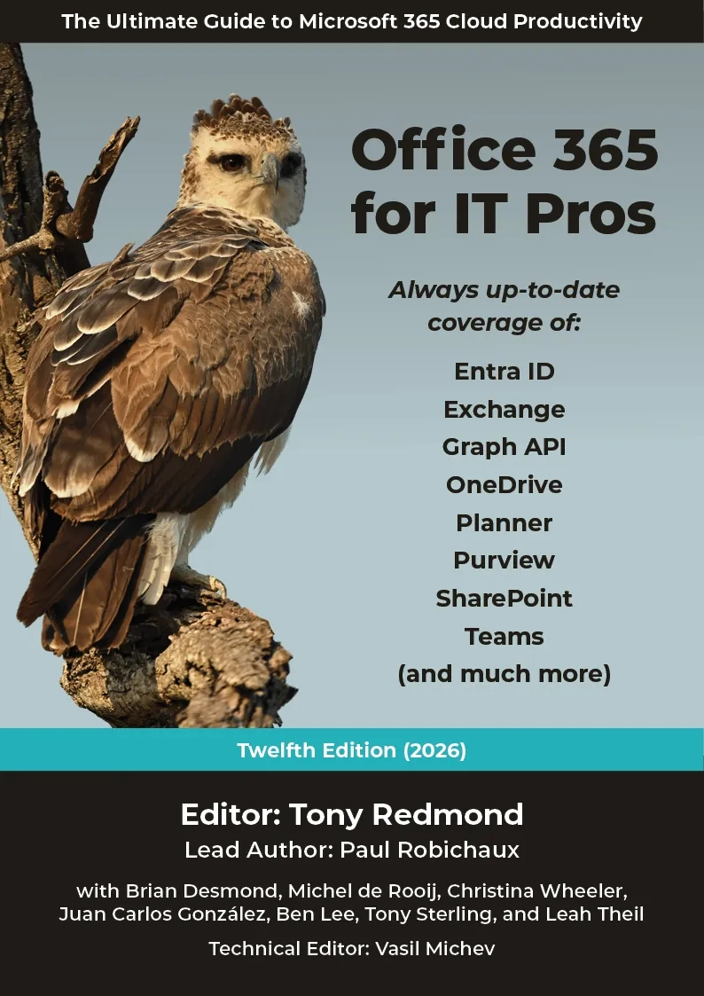
Office 365 for IT Pros
The best way to stay up to date with Microsoft 365:
Office 365 for IT Pros (2026 Edition). The Ultimate Guide to Managing Microsoft 365. (Includes the Automating Microsoft 365 with PowerShell eBook)
#CollabDaysBE2025

Slide 54

Questions?
##CollabDaysBE2025

